Slide 1
Insert customized info here

Slide 2
What will it take to prepare today’s students for the future?
Different kind of student population
Different kinds of challenges in social, economic and civic life
Different demands on schools
Notes:
Many are debating what will it take to adequately prepare students for a fast paced, fast changing world.
Student population is incredibly diverse. For the first time (2014-2015 school year) US student population is majority minority. Larger numbers of kids in poverty, English language learners, kids with disabilities. These kids are growing up with technology and the Internet.
The world they will enter after graduation is globally competitive, requires more knowledge workers who need to be creative, flexible, life long learners. The jobs they will hold many not even be invented yet. At the same time, the civic challenges we face as a country and society are getting more complex and the way that we engage in civic life is changing, with much of our information coming from digital sources and much of our participation happening online.
This places a very different set of demands on schools that were created to educate an agrarian population for the industrial age.

Slide 3
21st Century Learning
3 R’s plus 4 C’s
Critical thinking and Problem Solving
Communications
Collaboration
Creativity and Innovation
Student Centered
Personalized and adaptable
Digital
Notes:
Education leaders are coming to a consensus that schools need to provide a new kind of learning experience for students, “21st century learning.”
It includes mastering subjects like English, math, science, social studies and the arts. But also includes opportunities for kids to practice the 4 Cs of critical thinking, communication, collaboration and creativity. The 4 Cs are the skills employers most desire and find most lacking in today’s graduates.
And teaching is changing from teacher-focused (with teacher standing in front of the class lecturing or “dispensing knowledge” to student-centered, where kids are taking a greater role in the learning process. The technology makes it possible and easier to personalize learning for individual kids, for their tasks to adapt, becoming harder as the student progresses, or easier if the student is having trouble mastering the content.
And the Internet and mobile devices have brought the entire stock of knowledge to our fingertips, so how do we use powerful digital tools to help kids learn and master content in ways that encourage the 4 Cs?

Slide 4
A tipping point or perfect storm
FCC’s enhancements to e-Rate
ConnectED
New standards, curriculum and assessments
Affordable, powerful devices
Apps and administration
Notes:
More money is flowing into broadband services for schools and libraries.
FCC’s changes to the e-Rate have increased federal subsidies for broadband
The Administration’s ConnectED initiative is focused in increasing bandwidth to schools, adopting digital curriculum & devices, and professional development for teachers.
New college- and career-ready standards, the curriculum and tests that support them use more online resources and rely more and more on computer and online testing. That has driven demand for more devices in schools and more bandwidth for schools
The devices (laptops, tablets, smart phones, etc.) are becoming more affordable, more powerful and easier to use.
And there has been an explosion of education apps, student data management systems and learning management systems.

Slide 5
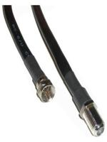
Searching for solutions
Notes:
[Animated Slide: Will take 4 clicks]
Everybody want’s a silver bullet. It’s only natural. Life would be so much simpler if there were one. But giving students laptops or tablets; bringing high-speed broadband into classrooms, none of that will magically transform schools, teaching or learning. Schools are complex organisms, with may pieces in play. Bringing about change is like trying to fit all the pieces of a big old complicated jigsaw puzzle together. You have to have all the pieces and they have to fit together and it sure isn’t easy.

Slide 6
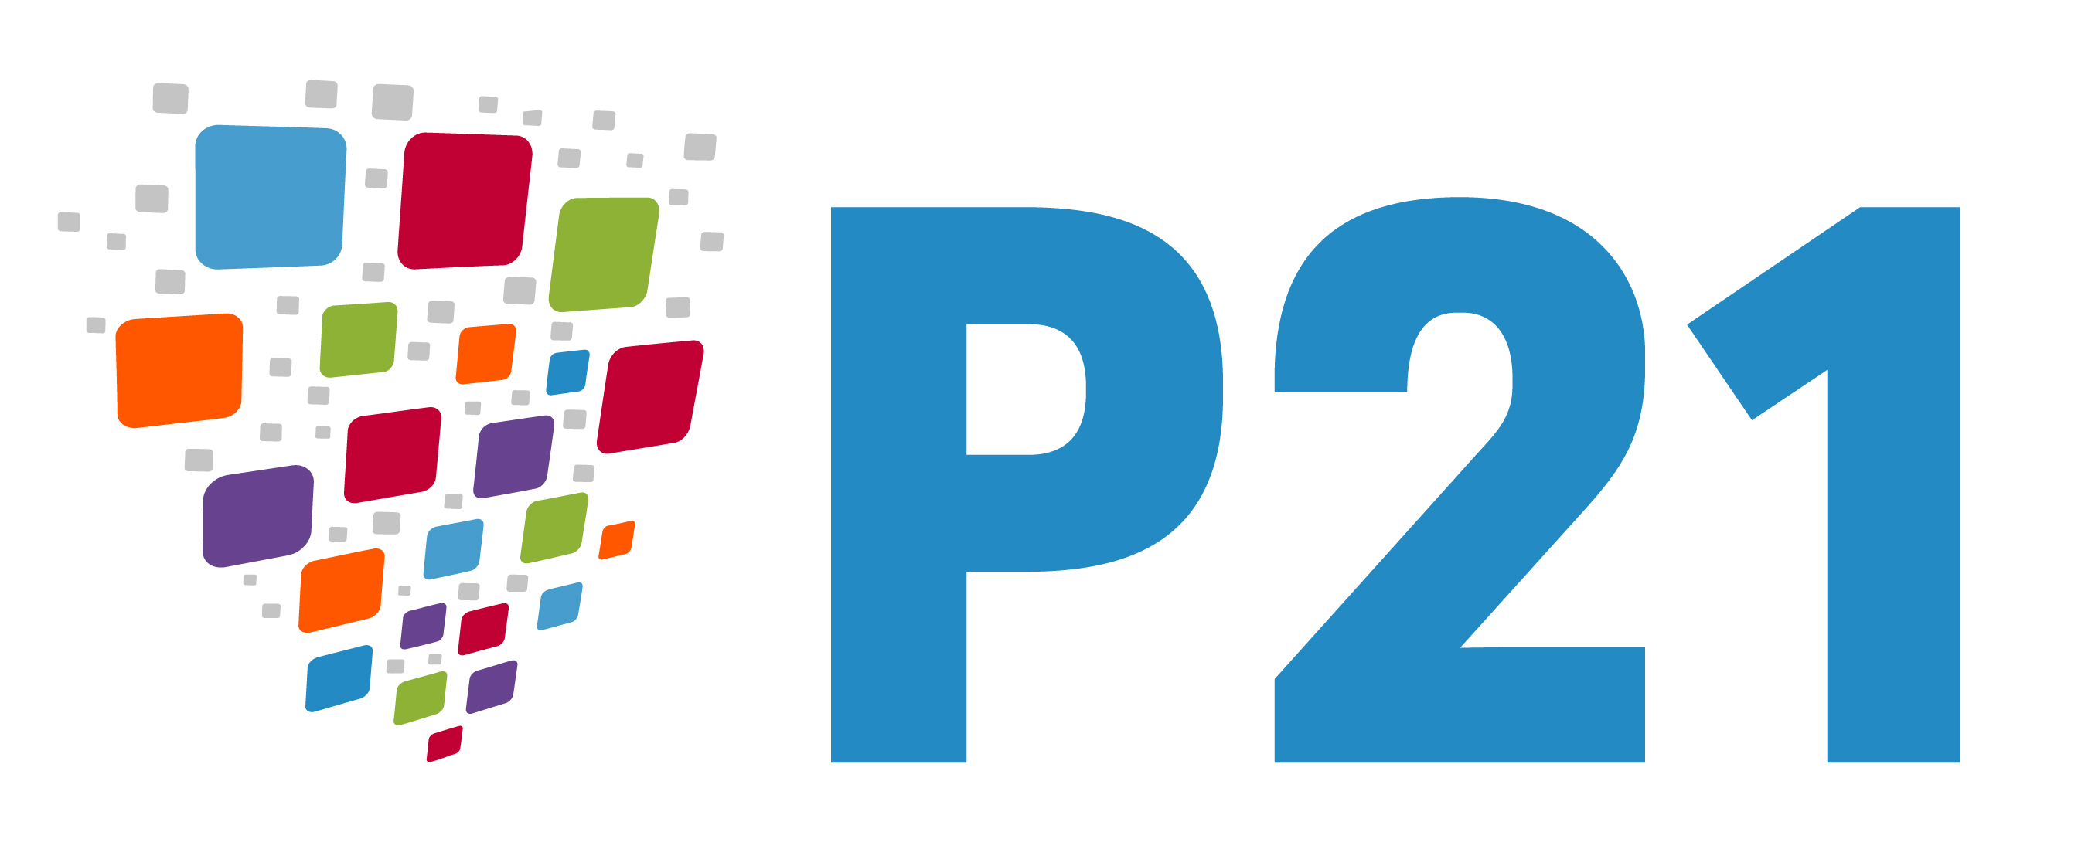
www.ncta.com/cableimpacts
www.p21.org
www.setda.org
Notes:
Too many times, school reform or technology initiatives have failed because either something was chosen as a “silver bullet” solution or the reform process didn’t put all the pieces together.
Three organizations came together to create a tool that would help school leaders, (whether within a school, a district or a state) map out a comprehensive plan that covers the major pieces of the school puzzle and gets the most value out of our investments in education. We gathered more than 40 education experts in five working groups, met over several months, and the result is “Building Your Roadmap to 21st Century Learning Environments” a planning tool for education leaders.
Roadmap is a free tool, copyright cleared under creative commons, provided as a public service by Cable Impacts Foundation, the Partnership for 21st Century Learning, and the State Educational Technology Directors Association.
[Brief descriptions of the three organizations:]
As the cable industry’s foundation dedicated to social responsibility, Cable Impacts leverages cable’s resources – including its platform, technology and content – to empower consumers and enhance communities. The foundation’s work targets: the advancement of education, increasing broadband adoption, and providing parents with the tools and resources to help their children appropriately and effectively use media.
P21 is the leading national organization committed to ensuring that all students graduate with deep content knowledge, and the creativity and innovation, communication, collaboration, and critical thinking skills required for postsecondary success in college, career, and citizenship. Guided by this goal, and a desire to promote innovative new approaches to teaching and learning, P21 supports cutting edge research, promotes evidence-based education policy and practice improvements, and encourages collaboration among education, business, and community leaders.
The State Educational Technology Directors Association (SETDA), founded in 2001, is the national non-profit association representing the interests of U.S. state and territorial educational technology leadership. SETDA’s mission is to build and increase the capacity of state and national leaders to improve education through technology policy and practice.

Slide 7
www.roadmap21.org
Notes:
The Roadmap tool is three pieces: a website, a report and a graphic. The graphic here helps us visualize the complexity of the planning process. We look at five main areas, from the technology infrastructure to the school’s leadership and culture and everything in between. As you can see, everything is connected and interrelated. Changes in one area will affect and be affected by all of the others. All sorts of individuals will play roles in planning and implementing change. Throughout the process, we have some guiding principals that help direct our efforts as we move through various stages, from planning to building to transformation.
There isn’t a single path or destination. Every community is different, as are its wants and needs. And every school system will find itself starting from a different place—maybe ahead in infrastructure but lagging in changing teaching and learning. Wherever your schools are and wherever they want to go, the Roadmap can help you get there.

Slide 8
Building on previous work
CEO Forum
National Education Technology Plan
LEAD Commission
ConnectED
Aspen Institute’s Learner at the Center of a Networked World
Hewlett Foundation’s Deeper Learning Initiative
P21 Framework for 21st Century Learning
Notes:
Our work was based on and expands on the work of many others, from the CEO Forum’s STaR Chart (School Technology and Readiness) in 1997, through the US Department of Education’s 2010 National Education Technology Plan to last year’s Aspen Institute report.

Slide 9
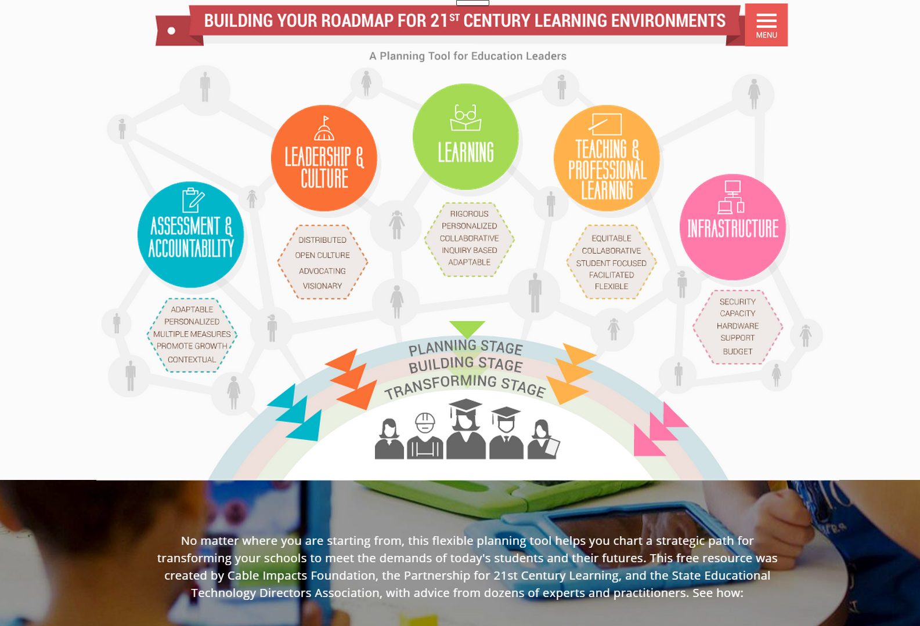
3 Components
Notes:
In addition to the graphic, an interactive website can walk you through the planning framework. And the deliberations, suggestions and comments from the working groups were captured in a report, which also gives the research and evidence behind many of the recommendations in the roadmap. Let’s take a deeper dive.

Slide 10
Within each of the 5 topics
Background
Connections
Stages
Principles
Key Questions
Action Steps
Policy Considerations
Exemplars
Notes:
Inside each topic (teaching, assessment, leadership, etc.) you will find:
Background information, data and research
Connections to and between other topics
A table describing the characteristics of each stage in the change process
Key principles to guide development and implementation of plans, so you don’t lose sight of what you’re trying to accomplish
A series of important questions you should be asking and which might be asked of you
Potential action steps to get you started
What policies stand in your way, which ones support you and which do you need to change or create?
What does this look like? Exemplars show what success looks like and how they got to where they are now.

Slide 11
Extensive written report
Downloadable (PDF)
All the research
Working groups’ guidance
Details, details, details
Extensive bibliography
Other planning resources
Notes:
The report can be downloaded on virtually any page on the website. It was written by Dr. James Marshall, a professor at San Diego State University, based on the research he and his colleagues did and on the thoughts, comments and guidance provided by the 40 experts who participated in the working groups.
The report contains many more details than the website, allowing a deeper dive into relevant topics and subtopics, and a very extensive bibliography full of sources for more information on anything in the report.
The Roadmap is a high-level tool designed to provide a structure or framework for making plans to create 21st century learning environments. There are a number of prescriptive tools available to help leaders make decisions on specific aspects of their plans and the report sends you to organizations like ISTE or the Alliance for Excellent Education or the Consortium on School Network for their planning tools..

Slide 12
Planning tool
Detailed guide
Thought piece
Explaining
Justifying
Notes:
The Roadmap was conceived as a planning tool, and can be used as a detailed guide through the entire planning process or more as a starting point, where everyone begins by developing a common understanding of the complexity of the task, adopts a planning framework and agrees on a set of guiding principles.
In particular, the graphic can be used in meetings and presentations to help people understand the complicated nature of school change and to see the interrelationships between each aspect of the planning process and each of the five topic areas.
It can also be used to explain to others, from parents to press to public officials, why school change is difficult and complicated, so they understand it is time consuming and resource intensive.
By showing the complexity and difficulty of change, the Roadmap can provide “air cover” for school leaders by being “third party validation” of their plans.

Slide 13
www.roadmap21.org
Notes:
Add a conclusion suitable for your audience, and invite them to explore www.roadmap21.org

