Slide 1
Welcome
CHAT Question
What is your role related to broadband implementation in K12 ?
*provider, IT director, SEA leader, researcher, administrator, teacher

Slide 2
About SETDA
SETDA is a non-profit membership organization with a mission to:
Serve, support, and represent U.S. state and territorial directors for educational technology.
Mission to build and increase the capacity of state and national leaders to improve education through technology policy and practice.
Forum for:
Advocacy for policy and practice
Professional learning
Inter-state collaboration
Public-private partnerships
Follow Us @setda
Notes:
Introduce yourself, review the key sections and any logistics for the session.

Slide 3
About SETDA Members & Partners
SETDA Members include:
State Leaders: Members from all 50 states, the District of Columbia, Virgin Islands, Guam & American Samoa. SEAs establish the membership and identify multiple participants. http://www.setda.org/states/
Affiliates: Organizations that through collaboration bolster efforts to advance education through technology policy and practice. Four Affiliate Categories: Statewide or Regional Membership Associations, Higher Education, International, Districts. http://www.setda.org/affiliate/
Private Sector Partners: Non-profit & for-profit private sector partners (platinum/gold/emerging) & channel partners that align with our mission, priorities, & advocacy goals. http://www.setda.org/partners/
Notes:
Introduce yourself, review the key sections and any logistics for the session.

Slide 4
Tools and Resources
SETDA has a track record of advocacy for equitable access to broadband on and off campus:
State Wi-Fi Leadership Case Studies
Broadband Imperative 2016
State K12 Broadband Leadership 2016
E-rate Modernization Resources
Broadband Imperative 2012
Notes:
SETDA is the principle association serving state leaders focused on the transition to digital learning – our mission is to build the capacity of state and national leaders to improve education through technology.

Slide 5
State K-12 Broadband Leadership 2019
Driving Connectivity, Access and Student Success

Slide 6
Agenda
Welcome and Introductions
Christine Fox, SETDA
Broadband State Leadership Highlights
Christine Fox, SETDA
State Broadband Map
Question & Answer Session

Slide 7
Thank You Sponsors

Slide 8
Background
Update from 2016 State Leadership Report
Collaborative work Broadband Working Group
State data collection, independent research

Slide 9
WHY ???
Notes:
Leveraging state funds for E-rate match
Statewide purchasing consortia shows significant cost savings
State broadband for education initiatives to aggregates buying power
Collaborative work via state DOEs, governor’s offices, business development organizations

Slide 10
Collaboration
Notes:
Leveraging state funds for E-rate match
Statewide purchasing consortia shows significant cost savings
State broadband for education initiatives to aggregates buying power
Collaborative work via state DOEs, governor’s offices, business development organizations

Slide 11
State Leadership
No one sizes fits all….
28 statewide K-12 education broadband network
9 states regional networks
16 states have alternative models,
(purchasing consortia, state master contracts and others)

Slide 12
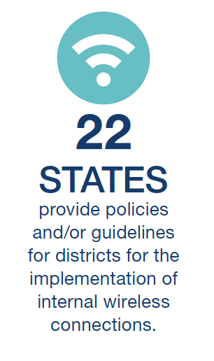
Policies and Guidelines

Slide 13
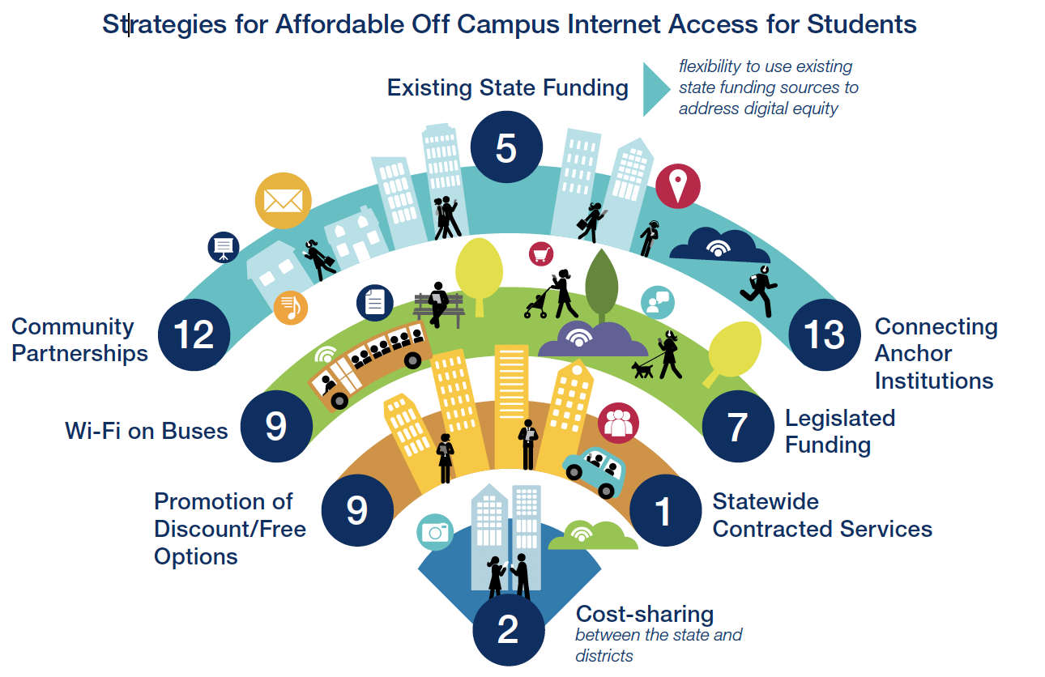
Off Campus Access

Slide 14
Funding
22 states provide direct state funding for broadband connectivity,
14 states provide state funding for internal wireless connections.
21 states offer a statewide contract for internal wireless connections that LEAs can purchase from.
7 states provide funding for off campus access.
* based on data from 48 states plus Guam
Notes:
State funding can help close the gap and provide affordable broadband options

Slide 15
State Case Studies
Notes:
State funding can help close the gap and provide affordable broadband options

Slide 16
Summary
State leadership is critical.
State approaches to broadband leadership vary greatly.
State education agencies should continue to work with other state agencies and regional organizations to coordinate projects to close the digital divide.
State leaders affect change and keep their states on the forefront of the digital

Slide 17
Chat Question
How has access to broadband changed teaching and learning in your schools?

Slide 18
Online Map
http://arcg.is/setdabroadbandmap

Slide 19
Online Map
The map includes the following details for states
State Leadership Overview
State Network Details
Regional Network Details
Alternative Model Details
State Strategies
State Broadband Funding
http://arcg.is/setdabroadbandmap

Slide 20
Coming Soon …...
Broadband Imperative 3
Fall 2019
Notes:
SETDA is the principle association serving state leaders focused on the transition to digital learning – our mission is to build the capacity of state and national leaders to improve education through technology.

