Slide 1
Ensuring Educator Effectiveness in the Digital Age Oregon Ed Tech PD Cadre
Carla Wade
Oregon Department of Education
October 2015
SETDA Education Forum

Slide 3
Road Descriptions
Dirt Road: There’s so much dust, I can’t see where I’m going! Help!!
Paved Road: It’s fairly smooth, but there are many potholes along the way.
Super Highway I feel fairly confident but have an occasional need to slow down.
Yellow Brick I ’m traveling along and could easily give directions Road to someone else.

Slide 4
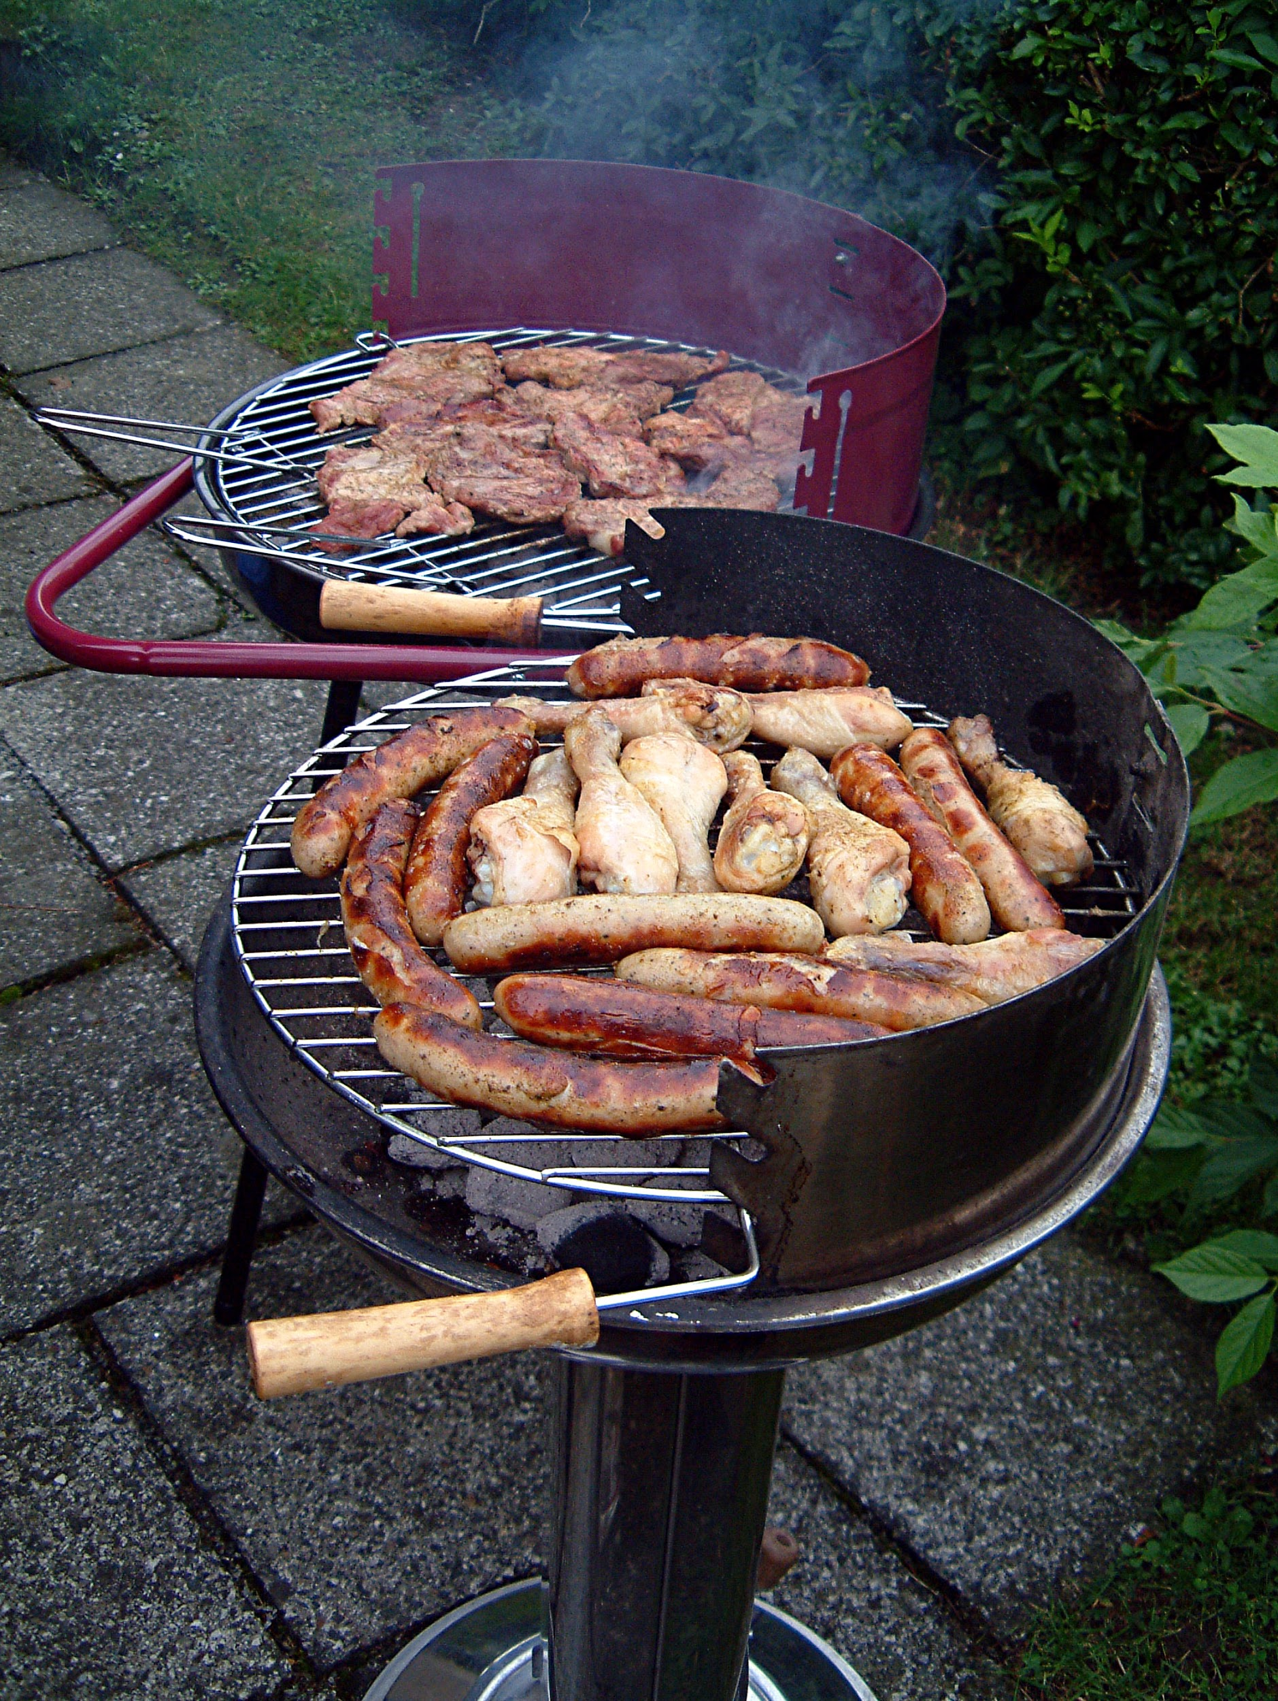
Which corner represents your barbeque skills?

Slide 5
Which corner represents your digital storytelling skills?

Slide 6
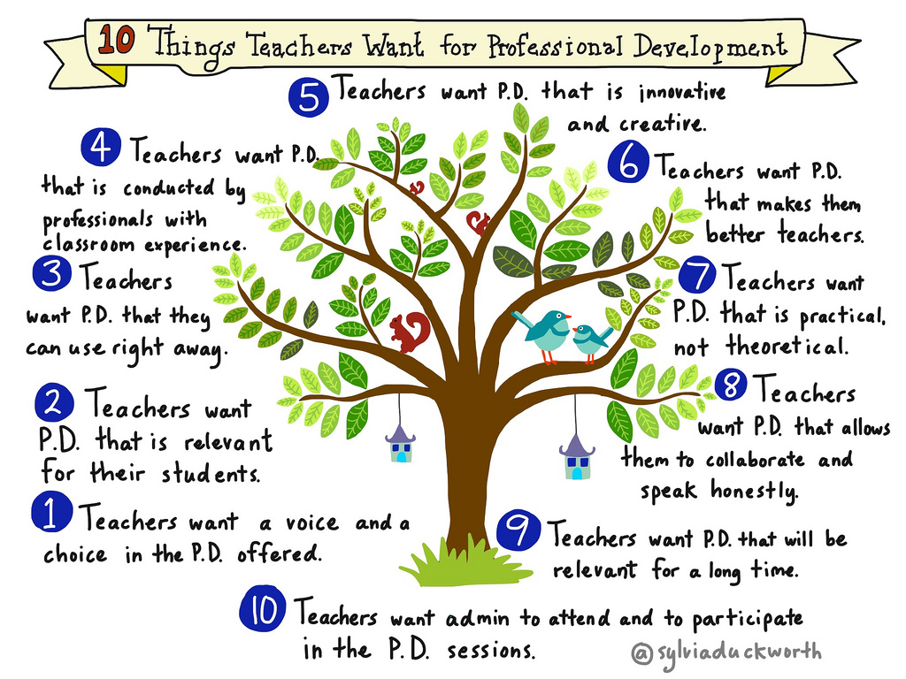
Which corner represents your professional development skills/experience?

Slide 7
Join Me
https://goo.gl/Z3eTmp

Slide 8
Cadre Goals
Networking and collaborative work
Integrating standards
Effective PD skills - coaching
Effective instructional strategies while demonstrating emerging technologies
Notes:
Integrating standards — Technology and CCSS

Slide 9
Sessions Session 1 Options: Room 1: Differentiating Instruction with Learning Menus and Modules Room 2: Protecting Our Community: Online Tools & Student Privacy Room 9: Get Your Flow On - Lesson Flows Session 2 Options: Room 1: Active Engagement/Opportunities to Respond Room 2: Google Classroom Room 9: What Basket?

Slide 10
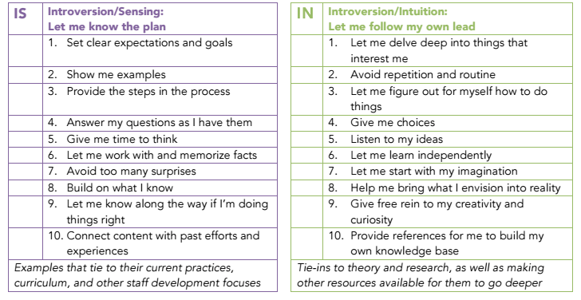

Slide 11
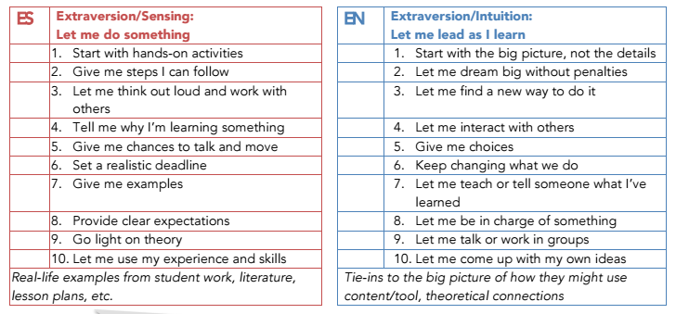

Slide 12
IS Introversion/Sensing Let me know the plan | IN Introversion/Intuition Let me follow my own lead
ES Extraversion/Sensing Let me do something | EI Extraversion/Intuition Let me lead as I learn

Slide 13
My ideal staff development day has clear, practical goals. We know why the agenda was chosen and have an outline of the important learnings of the day. The content relates to frameworks or subjects we’ve learned about in the past and is relevant to my needs in the classroom. We have chances throughout the day to reflect on what we’re learning, especially how we will use it, either quietly or in very small groups. | My ideal staff development day would consist of about six hours of independent study and an hour (maybe) with the big group. Give me the background materials to read in advance and a scenario to try them out with or exercises for thinking through the implications of what we’re learning. That day, I may wish to review other related resources of my choosing and then, at the end, share my insights with colleagues and learn from them. Even better, give me choice in what I pursue – or let me be involved in selecting the choices.
During my ideal staff development day, I’d receive ideas and tools I could use right away in my classroom. Hopefully it builds on skills I’ve learned in the past. Give me a brief overview of what we’re learning and why it works – go light on theory. Answer all my questions about it. Then let me discuss how it might affect my students and ways to perfect it with my colleagues. I’d prefer to try it in my classroom immediately; it’d be great if you could join me, either to co-teach or to give feedback on what I did effectively as well as where I need improvement. | For an ideal staff development day, I’d have a role in the planning, making sure the content and activities are novel enough to keep everyone’s attention. Any new focus could be interesting – brand-new areas for exploration are best in my book. Give us plenty of time for group activities and discussion. Changing agendas in the midst of the day is fine, too, if our discussions take us in a new direction. And, forget the details. I can read those later when necessary.

Slide 14
PD Session Debrief
Use:
I noticed the presenter
I noticed the students
I heard...
I saw...
I observed...
Avoid:
I liked
I didn’t like
good
bad
judgement

Slide 15
Internalizing the C.O.R.E
From the Bob Pike Group
Listen for key words in each section

Slide 16
Photo by practicalowl - Creative Commons Attribution-NonCommercial License https://www.flickr.com/photos/55046645@N00
Created with Haiku Deck

Slide 17
Photo by mickdolphinone - Creative Commons Attribution-NonCommercial License https://www.flickr.com/photos/32105441@N04
Created with Haiku Deck

Slide 18
REVISITORS

Slide 19
Photo by lucy... - Creative Commons Attribution-NonCommercial License https://www.flickr.com/photos/59653478@N00
Created with Haiku Deck

Slide 20
C.O.R.E in your PD
Closer - develop action plan, celebratory, ties it all together
Opener - must break preoccupations, time to connect to each other and content, bridge to the content
Revisiter - participant should say things again, hit it 6 times in 6 ways
Energizer - mental stimulators and physical activators, not always related to content, laughter

Slide 21
CORE Scavenger Hunt
In your table group “letter off” C - O - R - E - repeat...
Navigate to Teach.OETC.org and click on Strategies
8 minutes to dig through site and find a strategy to meet your letter
Be ready to share your strategy with the rest of the table

Slide 22
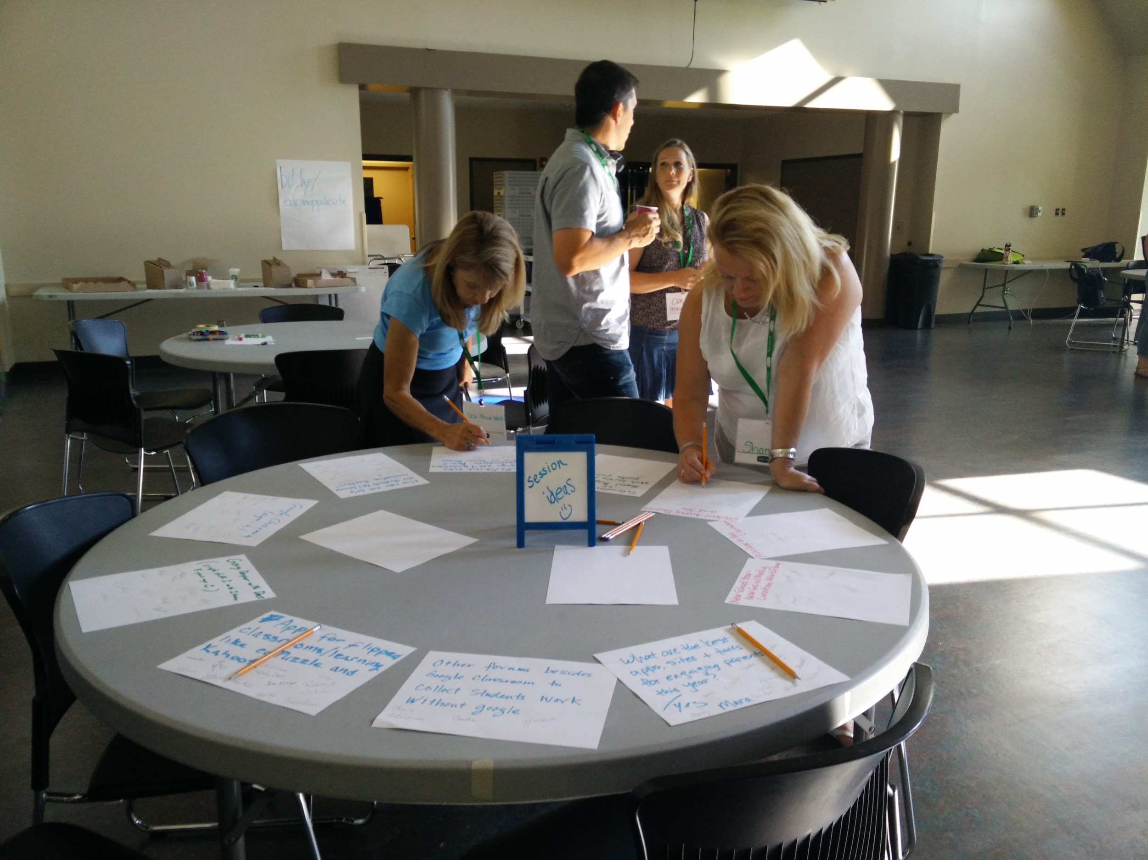
Unconference
Suggest topics using Tricider
#pdcadre
goo.gl/6nGfjH

Slide 23
Speed Geeking
Google Doc to Share Your Resources
Name of resource
Brief description
Device compatibility
60 seconds, total

Slide 24
3 things you learned
2 things you will share with colleagues
1 thing you will implement or change related to your job because of the learning
https://docs.google.com/forms/d/1fyCkjdRP8YVwWjgcs0z7bKb34SJFzvThJG3604IAyHw/viewanalytics
https://en.wikipedia.org/wiki/File:Mount_Hood_reflected_in_Mirror_Lake,_Oregon.jpg

Slide 25
Fall 2015 Cadre Evaluation Results
https://docs.google.com/forms/d/1fyCkjdRP8YVwWjgcs0z7bKb34SJFzvThJG3604IAyHw/viewanalytics

