Slide 1

Managing the Privacy of Student Data
Paige Kowalski,
Data Quality Campaign

Slide 2


Education is Changing
increasing data demands
evolving technology
need for new approaches for ensuring privacy

Slide 3
Focus of State and Federal Privacy Conversations
Collection
How are data gathered?
What types of data are gathered?
Is parental consent needed?
Access
Who can see these data?
Who can use these data?
Role-based access: Federal, State, District, Research.
Sharing
Who can a school district or state export these data to?
Implications for community partners, other agencies/sectors, researchers.

Slide 4
What does this mean for
states?

Slide 5
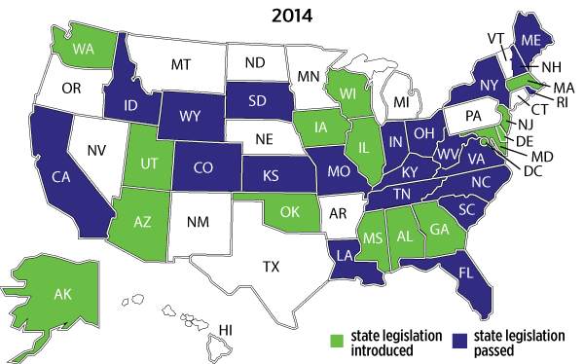
2014 State Legislative Activity
110
  bills related to student data privacy in
36 states
Notes:
One year ago there was one piece of legislation related to student data privacy
In the 2014 legislative session, DQC has recorded 110 bills introduced in 36 states, including 21 bills that have been passed into law
States are also taking action through executive orders and state board action
Executive Orders
Georgia: Affirmed prohibitions on sending PII to the federal government.
Maine: Affirmed commitment to student privacy rights.
Iowa: Confirmed the state DOE provides only aggregated student-level data to the federal government.
State Board Actions
Louisiana: Created a task force to validate data storage, security, and sharing practices at the district and state levels.
Alabama: Passed a policy to ensure that all state education data are collected, managed, and used in secure ways.
West Virginia: Submitted an amendment requiring transparency about data collection, governance, and parent compliant procedures.

Slide 6
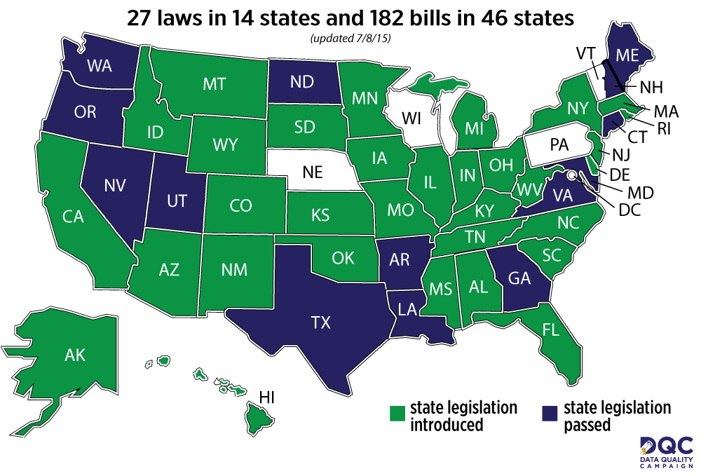
2015 State Legislative Activity
184
  bills related to student data privacy in
46 states

Slide 7


Louisiana: A case of unintended consequences
“In Louisiana, a data privacy bill led to administrative headaches and potential inequities by requiring parent permission for students’ data to leave the district even for purposes such as determining college financial aid and scholarships.”
– The Washington Post
Notes:
Quote comes from: http://www.washingtonpost.com/opinions/how-virginia-avoided-a-privacy-headache/2015/04/17/bd612202-da4c-11e4-8103-fa84725dbf9d_story.html

Slide 8

Georgia’s Student Data Privacy, Accessibility, and Transparency Act (SB 89)
Combines provisions from many of last year’s most robust governance and transparency bills
Covers state data, with the online service provider governance aspects of the SOPIPA law that California passed last year
    Would prohibit service providers from using data for commercial purposes
Protects student privacy and promotes the use of data to improve student achievement
Notes:
Its comprehensive approach makes this law one of the most comprehensive and nuanced we’ve seen.
The Foundation for Excellence in Education put out a statement commending Georgia’s Governor Deal for signing the bill.
Press release about GPEE’s Flashlight award win: http://dataqualitycampaign.org/news-events/press-releases/georgia-partnership-for-excellence-in-education-awarded-for-work-to-ensure-data-use-improves-student-achievement/

Slide 9
What does this mean for
congress?

Slide 10

Federal Role in Safeguarding Student Data
Ensure federal laws provide a strong foundation to protect student information
Coordinate across agencies to provide clarity to schools as to how laws work together
Support state and local capacity to safeguard data

Slide 11
Federal Student Privacy Activities in 2015
FERPA Amendments (Rokita-Fudge)
  Access for research and community partners
ESEA Reauthorization
  Student Data Privacy Policy Committee (Markey-Hatch)
  ITECH program with data literacy training
Messer-Polis and Blumenthal-Daines Bills
  Use of student data by service providers

Slide 12
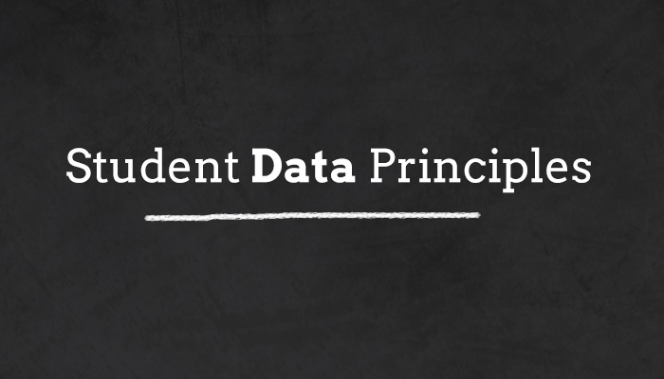
Notes:
DQC and CoSN led a coalition of national stakeholders in determining a set of fundamental beliefs for using and protecting student data that will guide the work of the education community
Together we developed the Student Data Principles, which are supported by 24 national education organizations to date. All of us believe passionately in the effective use of data to support student learning and success.
Rather than a legal or technical document, these principles are a set of beliefs that guide our work, and that we believe should guide the work of everyone who uses student information to support learning and success.

Slide 13

Data should…
  Support student learning
  Foster continuous improvement
  Inform, engage, and empower
  Be accessible to parents, students, and educators
  Inform professional judgment of educators
  Only be shared for authorized purposes
Notes:
These are 10 beliefs we share about how students’ personal information should be used and protected.
Whenever possible, aggregated data that do not identify individual students should be used to inform key policy decisions and help improve services and systems that benefit students. In instances where using personal information is necessary, those few individuals who have access to this information to carry out their duties must handle it in a legal, responsible and ethical manner

Slide 14

Everyone with access to student information should have…
Clear, publicly available rules
Access to only what they need
Training

Slide 15

10. Institutions that collect and maintain student
information should have…
  Governance
  Transparency
  Security
  Communications
Notes:
Emphasize that communications means having somewhere for students and families to go to learn about their rights and have their questions answered

Slide 16

Stay updated!
StudentDataPrinciples.Org
#StudentDataPrinciples
Notes:
Stay tuned for more news on the student data principles and make sure to visit StudentDataPrinciples.org to see student data privacy resources and testimonials of the power of effective education data use.

Slide 17

dataqualitycampaign.org
Paige Kowalski
Paige@dataqualitycampaign.org

