Slide 1
The E-rate Opportunity
Supplemental Slides
Notes:
The following slides discuss E-rate modernization in greater depth than the Policymaker and Digital Leader decks. State leaders should pull slides from this deck as necessary to best present E-rate to different audiences.

Slide 2
Supplemental Slides
New Connectivity Targets
Category One vs. Category Two
Modernization Highlights
Lit v. Dark Fiber Definitions
Lit v. Dark Fiber Rules
Amortization of Special Construction Costs
Expanded Budget for Wi-Fi: Category Two and Eligible Services
How Broadband Flows
Mt. Everest Graphic
E-rate Application and Funding Timeline

Slide 3
New Connectivity Targets
Schools
Short Term: 100 Mbps Internet access per 1,000 students and staff (users)
Long Term: 1 Gbps Internet Access per 1,000 users.
Libraries
100 Mbps for libraries serving <50,000 patrons
1 Gbps for libraries serving >50,000 patrons

Slide 4
Category One vs. Category Two
Old Rule
Funding requests divided into “Priority One” and “Priority Two” categories.
Priority One (telecommunications, telecommunications services, and Internet connections) funding requests received first priority. Most requests fulfilled by E-rate.
Priority Two (internal connections) requests received remaining funds. Requests are rarely funded, unpredictable.
New Rule
Priority One requests relabeled “Category One”; Priority Two requests relabeled “Category Two”.
Category One (telecommunications, telecommunications services, and Internet Connections) requests funded normally.
Category Two (internal connections) requests funded with a new $1 billion annual budget. Support for Category Two requests more predictable, reliable. **
Please note: If Category 1 requests overrun their threshold the FCC will dip into Cat 2 funds therefore reducing the Cat 2 $1billion.
Notes:
Please note: If Category 1 requests overrun their threshold the FCC will dip into Cat 2 funds therefore reducing the Cat 2 $1billion....

Slide 5
Modernization Highlights
Provides an incentive for state support of last-mile broadband facilities through a match from E-rate of up to 10% of the cost of construction
Expands the five-year budget for internal connections (Wi-Fi) and provides a $150-per-student (pre-discount) budget for schools over a 5-year period.
Raises E-rate spending cap to $3.9 bil.
Suspends the requirement that applicants seek funding for large, up-front construction costs over several years, and allows applicants to pay for up-front construction costs over multiple years
Notes:
(We will be focusing on these two for the remainder of the deck).

Slide 6
Modernization Highlights (Cont.)
Equalizes the treatment of dark and lit fiber
Allows schools and libraries to build high-speed broadband facilities themselves (when that is the most cost effective option)
Requires carriers that receive subsidies from the universal service program for rural areas (the Connect America Fund program) to offer high-speed broadband to schools and libraries in the subsidy areas at rates comparable to similar services in urban areas
Notes:
(We will be focusing on these two for the remainder of the deck).

Slide 7
Lit vs. Dark Fiber Definitions
Lit fiber services include both the physical fiber as well as the necessary electronics (transmitters and regenerators) to provide transmission services (send and receive data) across fiber managed by a provider.
Dark fiber leases permit a customer to purchase fiber capacity on a provider-owned and maintained fiber network without paying for transmission service. The applicant bids separately for the modulating electronics required to “light” the fiber (transmit data) and accepts the responsibility for maintenance, repairs, and uptime metrics.

Slide 8
Lit vs. Dark Fiber Rules
Old Rule
E-rate rules prioritized lit over dark fiber.
New Rule
Lit and dark fiber treated equally.
Modulating electronics to light dark fiber are now eligible for Category One support.
Restrictions
To receive discounts for dark fiber, applicants must submit an RFP for both dark and lit services.
Dark fiber must be the most cost-effective option for applicants to receive discounts. In comparing bids, applicants must include equipment and maintenance costs associated with lighting dark fiber in the same application with a dark fiber lease.
Applicants will only receive special construction support for dark fiber lit in the same funding year.

Slide 9
Amortization of Special Construction Costs
Old Rule
Applicants required to amortize non-recurring special construction costs for Category One broadband charges exceeding $500,000 over multiple years.
Applicants had to pay non-discounted portion of non-recurring constructions charges over 90 days.
New Rule
Suspends the amortization requirement for four years (FY2015-FY2018).
Applicants, in agreement with a service provider, can pay their non-discounted portion of non-recurring construction costs over four years.
Must be included in RFP
Applicant can use a service provider’s willingness to spread payments as criteria in competitive bid decision-making.

Slide 10
Expanded Budget for Wi-Fi
Category Two and Eligible Services
Category Two Services: Replace “Priority Two” services, include internal connections and services (including managed services and maintenance) needed to provide broadband connectivity throughout a school or library building to get connectivity to the student in the classroom.
Eligible Services Include:
Access points used in a LAN or WLAN environment
Antennas, cabling, connectors and related components for internal broadband connections
Firewall services and components
Switches, routers, racks
UPS/battery backup
Wireless controller systems
Software supporting the components
Caching
Notes:
(We will be focusing on these two for the remainder of the deck).

Slide 11
How Broadband Flows
School District Network
Public Internet
Access made possible through an Internet Service Provider (ISP)
Internet Access Aggregation Point (ex., District Data Center)
1) Internet Access
2) Wide Area Network
3) Internal Connections (Wi-Fi/WLAN)
Adopted from the First Modernization Order, pg. 16.
Notes:
We need to

Slide 12
Mount Everest Graphic
Notes:
This graphic demonstrates visually how far we have come since E-rate was first implemented and how far we still have to go. Has been used successfully by SETDA members in the past.

Slide 13
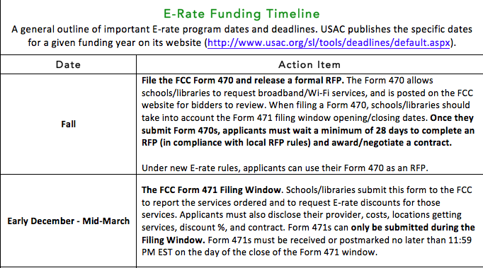
E-rate Application and Funding Timeline
Notes:
(We will be focusing on these two for the remainder of the deck).

Slide 14
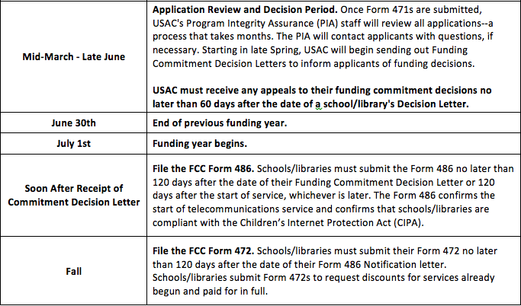
E-rate Application and Funding Timeline
Notes:
(We will be focusing on these two for the remainder of the deck).

Slide 15
Contact Information
[Insert State Contact]
FCC Contacts:
Dana Shaffer, Deputy Managing Director (dana.shaffer@fcc.gov)
Charles Eberle, Attorney Advisor, Wireline Competition Bureau (Charles.Eberle@fcc.gov)
Joe Freddoso, Dark Fiber Consultant - USAC (jfreddoso@gmail.com)
Christine Fox, Director of Educational Leadership and Research, SETDA (cfox@setda.org)
Susannah Savage, Honors Policy Associate, Common Sense Kids Action (ssavage@commonsense.org)

Slide 16
About Us
SETDA and Common Sense Kids Action are working together to help finish the job of connecting all classrooms and libraries to the Internet by 2018.
Founded in 2001, the State Educational Technology Directors Association (SETDA) is the principal nonprofit membership association representing US state and territorial educational technology leaders. Our mission is to build and increase the capacity of state and national leaders to improve education through technology policy and practice. setda.org
Common Sense Kids Action works with policy makers, business leaders, and other advocates to ensure that every child has the opportunity to succeed in the 21st century. Our mission is to make kids and education our nation's top priority by building a membership base and driving policies that promote access for all kids to 21st-century schools, protect their online privacy, invest in early childhood supports, and reduce child poverty. https://commonsensemedia.org/kids-action

