Slide 2
Agenda
Welcome & Introductions
Lan Neugent, SETDA
State Procurement Overview
Lan Neugent, SETDA
State Perspective
Texas Education Agency
Utah State Department of Education
Digital Instructional Materials Procurement for States Portal (DMAPS) Overview
Christine Fox, Director of Educational Leadership and Research
Q and A
Facilitated by Lan Neugent

Slide 3
State Educational Technology Directors Association
Serve, support, and represent U.S. state and territorial directors for educational technology.
Mission to build and increase the capacity of state and national leaders to improve education through technology policy and practice.
Forum for:
Advocacy for policy and practice
Professional learning
Inter-state collaboration
Public-private partnerships
Notes:
SETDA is the principle association serving state leaders focused on the transition to digital learning – our mission is to build the capacity of state and national leaders to improve education through technology.

Slide 4
Tools and Resources: Digital Content
SETDA has a track record of advocacy for digital learning:
OER Case Studies 2015
Digital Content Policy Briefs 2014-2015
Guide to Implementing Digital Learning 2014
Out of Print Report 2012
Broadband Imperative 2012
Notes:
SETDA is the principle association serving state leaders focused on the transition to digital learning – our mission is to build the capacity of state and national leaders to improve education through technology.

Slide 5
New Online Portal
The Digital Instructional Materials Acquisition Policies for States (DMAPS)
An online database providing state and territory policies and practices related to the acquisition of digital instructional materials in K12 education.
Notes:
New National Report will be released at the Leadership Summit - Infographic

Slide 6
Thank You

Slide 7
Procurement
Digital Instructional Materials Proliferation
Procurement Complexities
DMAPS Procurement - A Start
Next Steps

Slide 8
Presenters
Kelly Callaway, Division Director, Instructional Materials and Educational Technology,
Texas Education Agency
Allan Griffin, Curriculum Content Specialist,
Utah State Office of Education
Christine Fox, Director of Educational Leadership and Research, SETDA

Slide 9
Utah’s Instructional Materials Review Process and Digital Initiatives
SETDA Webinar, October 7, 2015

Slide 10
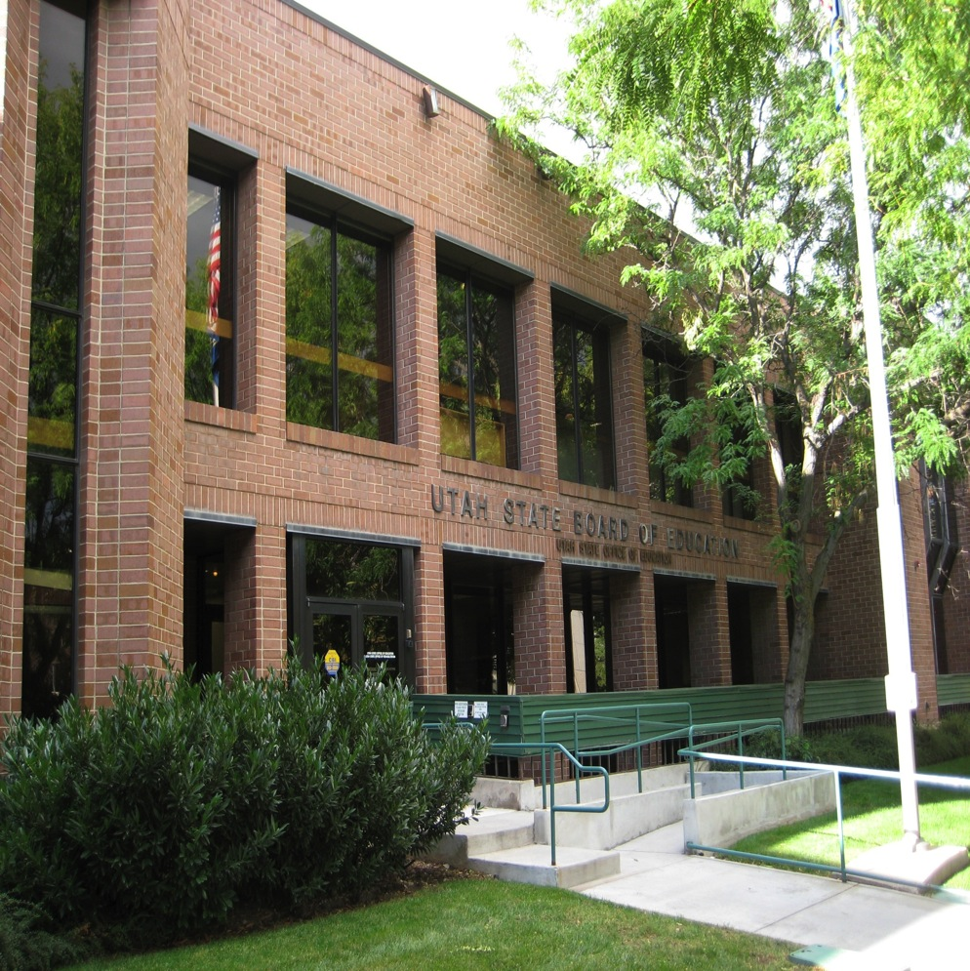

Slide 12
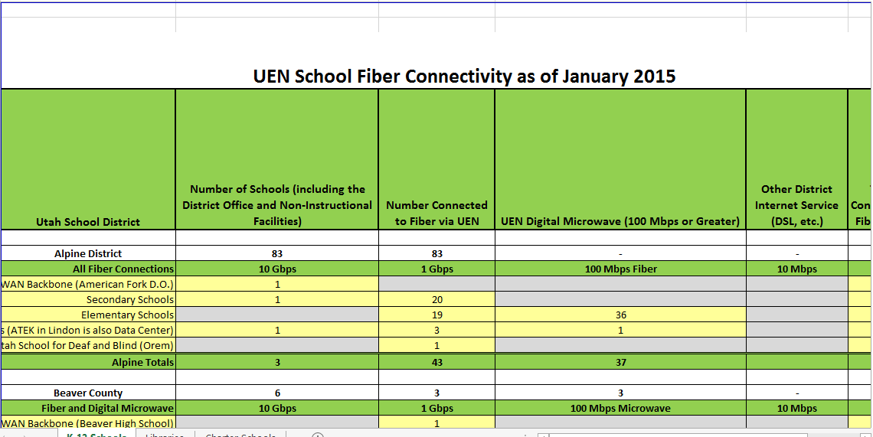

Slide 14
WHEREAS, pursuant to UCA §53A-14-101 thru 107, the State Board has appointed a State Instructional Materials Commission to vet educational curriculum and make recommendations to teachers as to whether the textbooks, teaching materials and lesson plans reviewed are aligned to the Utah Core Standards.
BE IT AFFIRMED, that the Utah State Board of Education will continue to provide as a resource to local school boards, charter school boards of trustees, traditional public schools, and teachers access to the RIM database in order to assist in the selection of appropriate textbooks, teaching materials and lesson plans.

Slide 19
Contact Information
Alan Griffin
Curriculum Content Specialist
Utah State Office of Education
Alan.griffin@schools.Utah.gov
SIMRA President

Slide 20
Texas Digital Resources Kelly Callaway Division Director, Instructional Materials and Educational Technology October 7, 2015

Slide 21
© 2015 by the Texas Education Agency
Copyright © Notice
The Materials are copyrighted © and trademarked ™ as the property of the Texas Education Agency (TEA) and may not be reproduced without the express written permission of TEA, except under the following conditions:
1) Texas public school districts, charter schools, and education service centers may reproduce and use copies of the Materials and Related Materials for the districts’ and schools’ educational use without obtaining permission from TEA.
2) Residents of the state of Texas may reproduce and use copies of the Materials and Related Materials for individual personal use only, without obtaining written permission of TEA.
3) Any portion reproduced must be reproduced in its entirety and remain unedited, unaltered, and unchanged in any way.
4) No monetary charge can be made for the reproduced materials or any document containing them; however, a reasonable charge to cover only the cost of reproduction and distribution may be charged.
Private entities or persons located in Texas that are not Texas public school districts, Texas education service centers, or Texas charter schools or any entity, whether public or private, educational or non-educational, located outside the state of Texas MUST obtain written approval from TEA and will be required to enter into a license agreement that may involve the payment of a licensing fee or a royalty.
For information contact
Office of Copyrights, Trademarks, License Agreements, and Royalties, Texas Education Agency, 1701 N. Congress Ave., Austin, TX 78701-1494; phone 512-463-7004; email copyrights@tea.texas.gov.

Slide 22
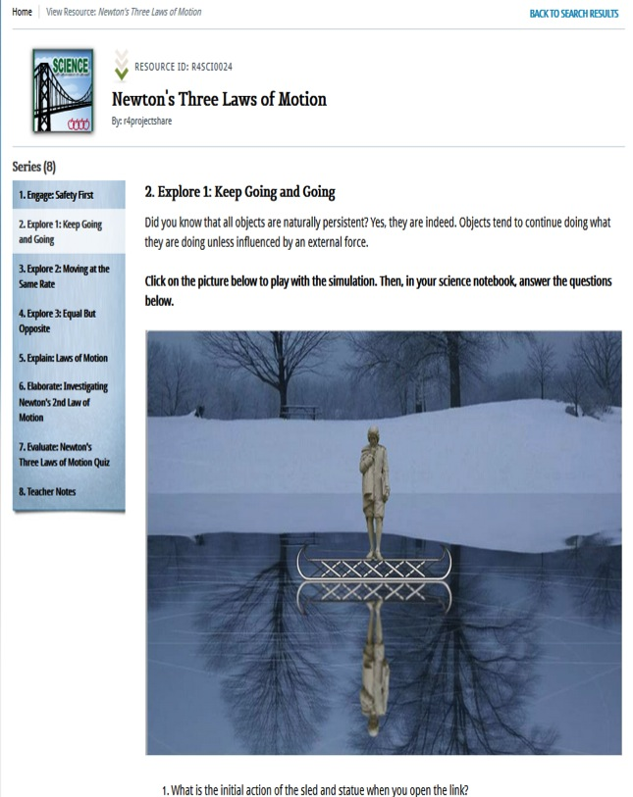
Project Share Gateway Resources
OnTRACK lessons are available for students in grades 7‒11 in
English,
Math,
Science, and
Social studies.

Slide 23
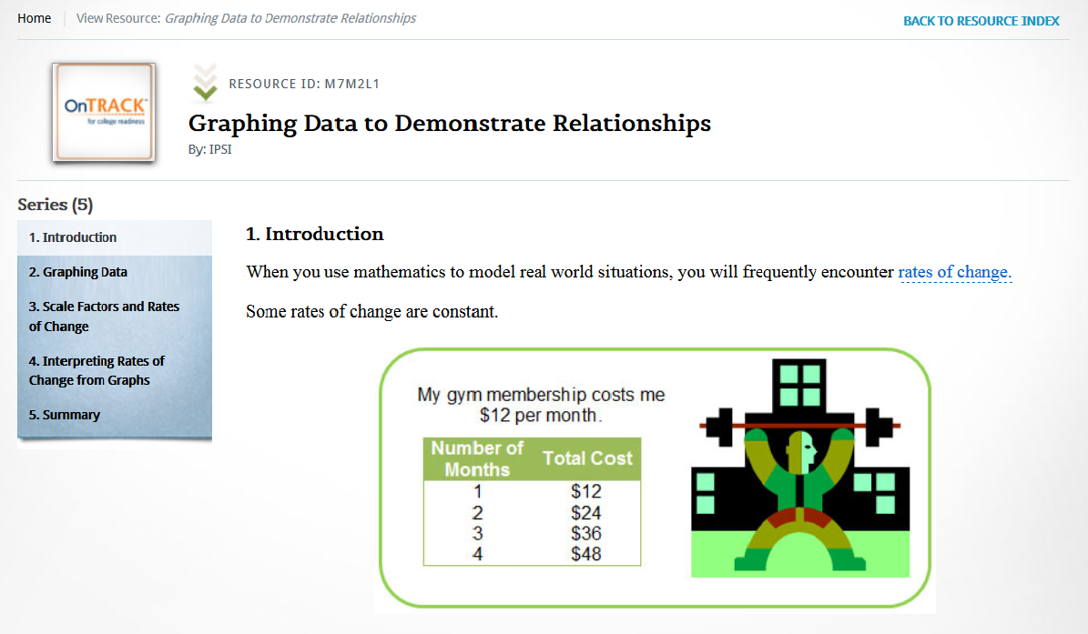
Project Share Gateway Resources

Slide 24
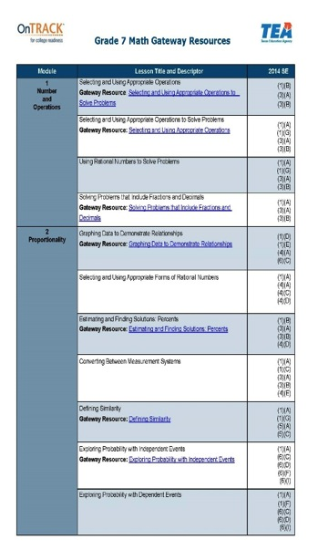
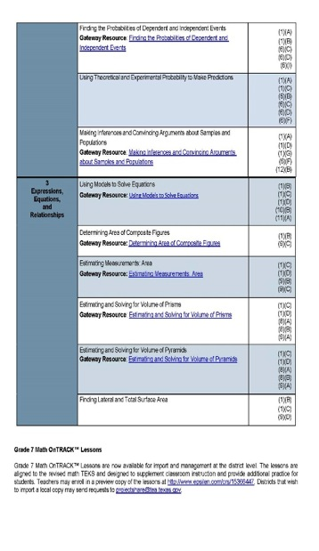
Project Share Gateway Resources
OnTRACK syllabi are aligned by TEKS to Project Share Gateway resources.
Contact projectshare@tea.texas.gov to request copies of the syllabi.

Slide 25
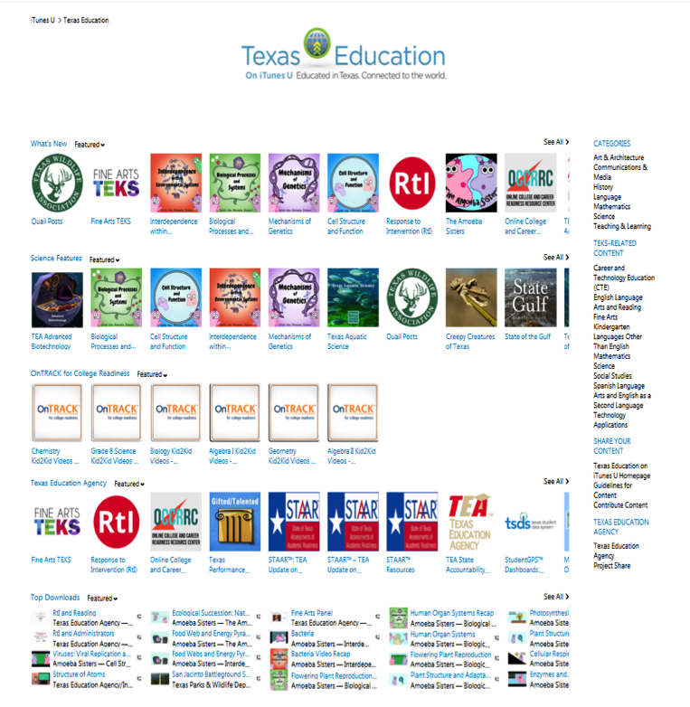
Texas Education on iTunes U

Slide 26
Texas Education on iTunes U
Closed captioned OnTRACK™ Kid2Kid Chemistry videos are now available.
Visit Texas Education on iTunes U to see the latest collections.

Slide 27
ESTAR/MSTAR Systems
The Elementary School Students in Texas: Algebra Ready (ESTAR) and Middle School Students in Texas: Algebra Ready (MSTAR) universal screeners and diagnostic assessments are available at no cost to all Texas public school districts and open-enrollment charters.
Professional development courses explaining how to use the systems and how to interpret the reports are also available.
For more information or assistance in enrolling, contact mathtx@esc13.net.

Slide 28
Adopted Digital Materials
Texas adopts digital materials in exactly the same way we adopt print materials.
All digital materials are required to meet the technical standards of the Federal Rehabilitation Act, Section 508 and conform to the Web Content Accessibility Guidelines (WCAG) 2.0, Level AA.
Materials submitted for Proclamation 2017 must be reviewed by a knowledgeable third party to verify they meet these standards.

Slide 29
Adopted Digital Materials
 | 2014 | 2015
Proportion of Instructional Materials Purchased in an Electronic Format | 41% | 86.98%
Proportion of Instructional Materials Allotment (IMA) Funds Spent on Digital Content | 42.91% | 92.96%

Slide 30
Information and Assistance
Contact us with questions:
projectshare@tea.texas.gov
instructionalmaterials@tea.texas.gov
reviewandadopton@tea.texas.gov
Follow us @projectshareTX.

Slide 31
New Online Portal
The Digital Instructional Materials Acquisition Policies for States (DMAPS)
- an online database providing state and territory policies and practices related to the acquisition of digital instructional materials in K12 education.
Notes:
New National Report will be released at the Leadership Summit - Infographic

Slide 32
Project Background
Focus groups with state educational leaders and representatives from the private sector
Interviews with lead educators from a variety of educational organizations
Interviews with state procurement officers
State data collection
Independent research
Notes:
SETDA’s State Action Committee helped provide a comprehensive overview of state practices related to the procurement of digital instructional materials. As part of the research, SETDA interviewed lead educators from a variety of educational and government organizations, state instructional materials leads and state procurement officers. In addition, SETDA conducted a data collection of all 50 states and US territories regarding state policies and guidelines for the acquisition, vetting, and funding of instructional materials.

Slide 33
Topics
Instructional Materials
Guidelines and Policies
Procurement
Funding
Digital Learning Resources
Vetting
State Background
Demographics
State Technology Standards
State and district technology planning

Slide 34
Site Features
• overview of states policies/practices
• state trends via heat map
• individual state profiles
• compare up to 5 states by topic
• print individual state profiles
• download spreadsheets by topic
• school/district exemplars
• state educational technology background details
resources

Slide 35
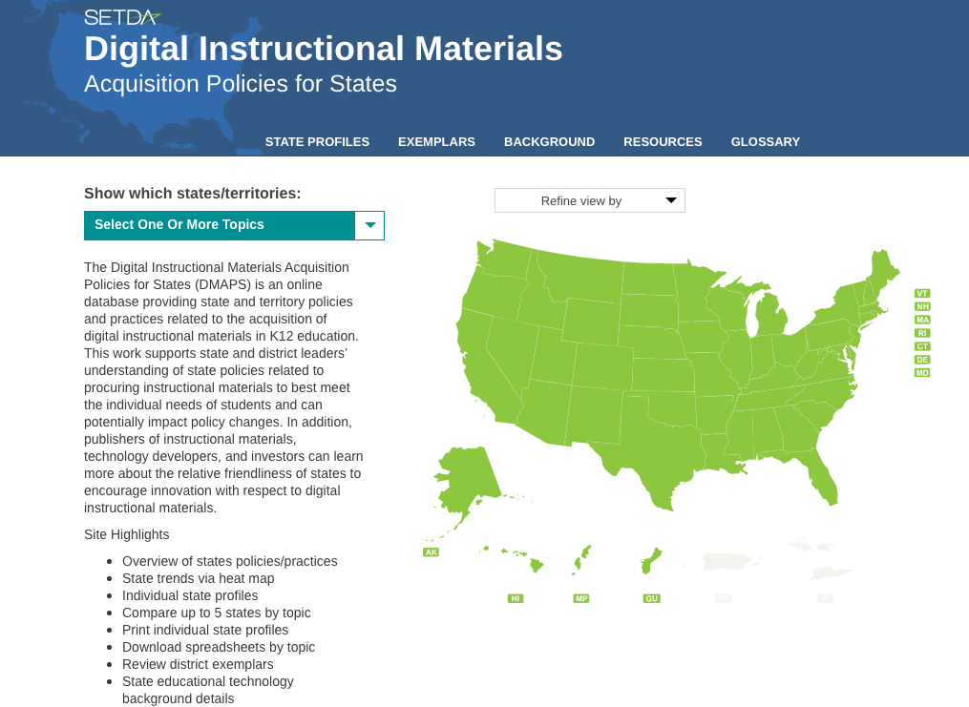
Home Page

Slide 36
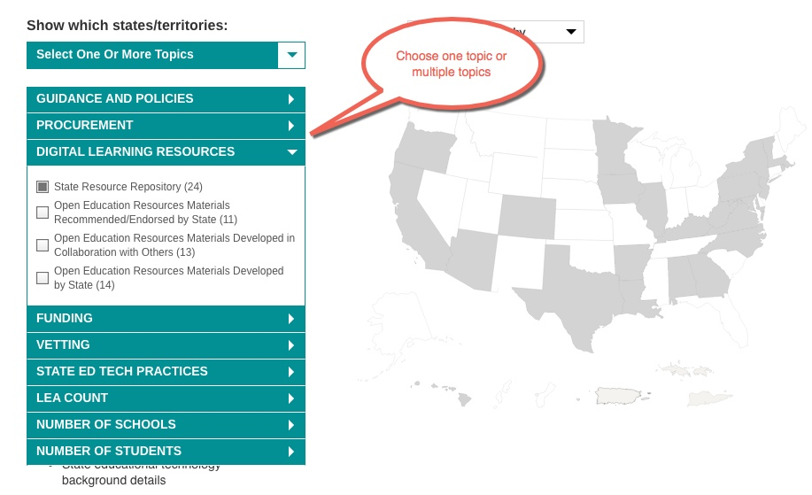
Topics by State

Slide 37
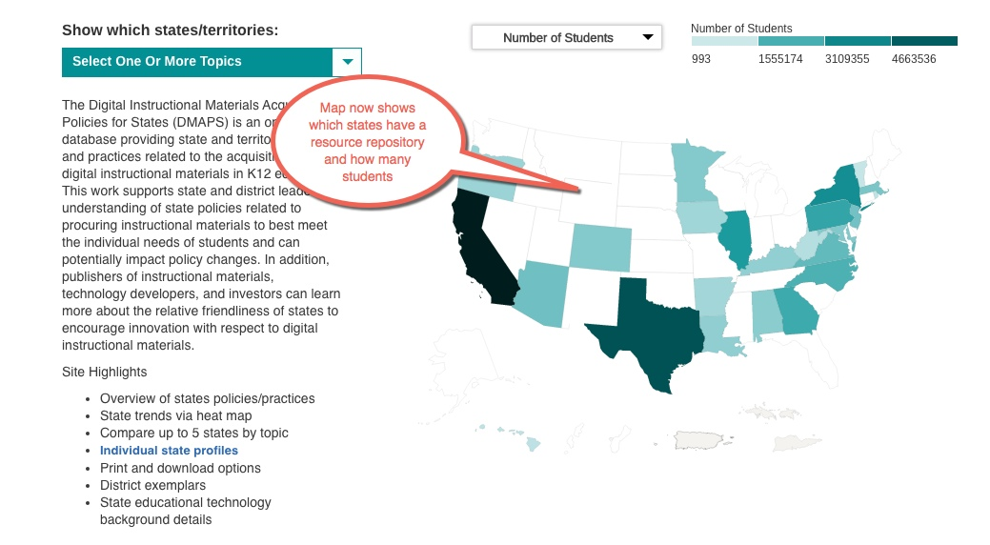
Map by Topic and Number of Students

Slide 38
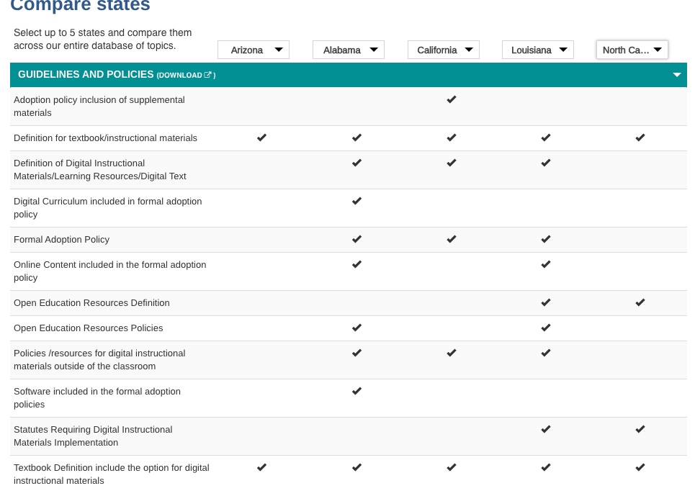
Table Comparison

Slide 39
State Profiles
Topic details including:
overview of state procurement practices and options
details regarding state policies, definitions and practices
links to resources with additional details.
ability to download and export state profiles

Slide 40
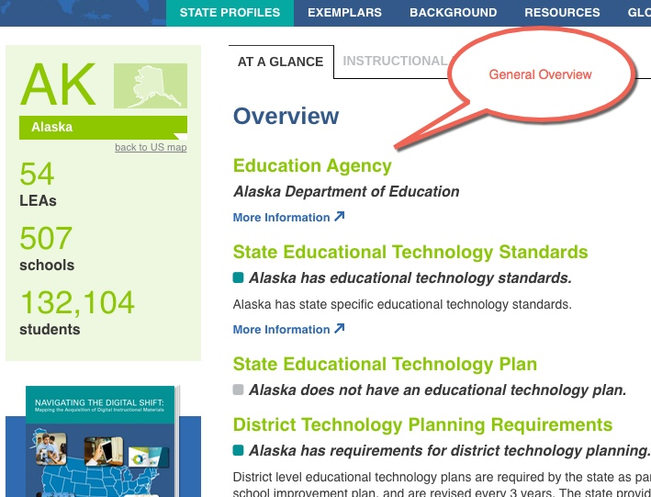
State Profiles At a Glance

Slide 41
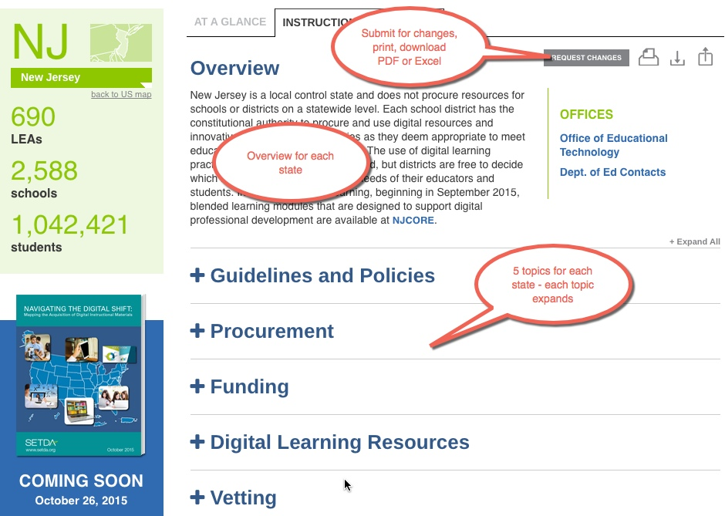
State Profiles Instructional Materials

Slide 42
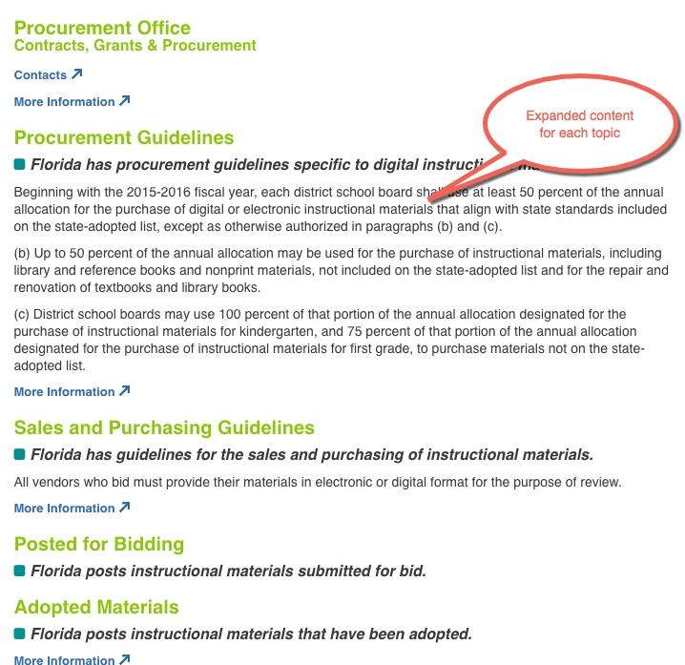
Deeper Dive by Topic

Slide 43
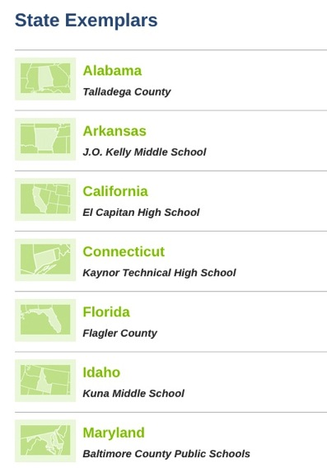
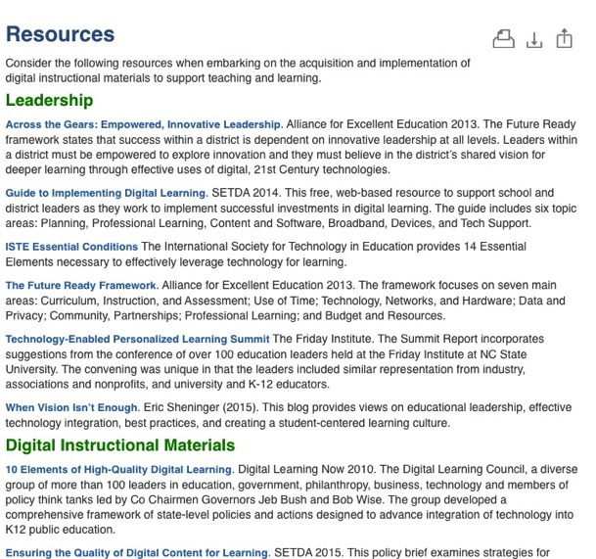
Other Features

Slide 44
Questions

Slide 45
Coming Soon…
National Report
NAVIGATING THE DIGITAL SHIFT:
Mapping the Acquisition of Digital Instructional Materials
Release
October 25
SETDA’s Leadership Summit

Slide 46
Continue the Conversation Live Twitter Chat
Join @SETDA and @ineLearn
Thursday October 8 at 9pm ET
Charting Transitions to Digital Instructional Materials
Hashtag #inelearn

