Slide 1
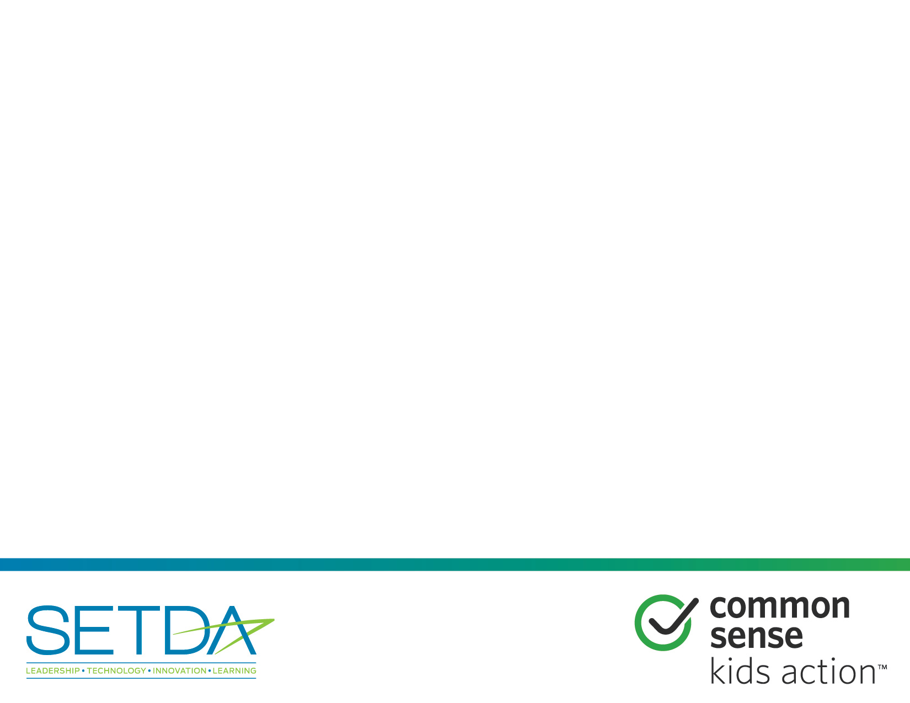
The E-rate Opportunity
E-rate Modernization Resources for Policymakers

Slide 2
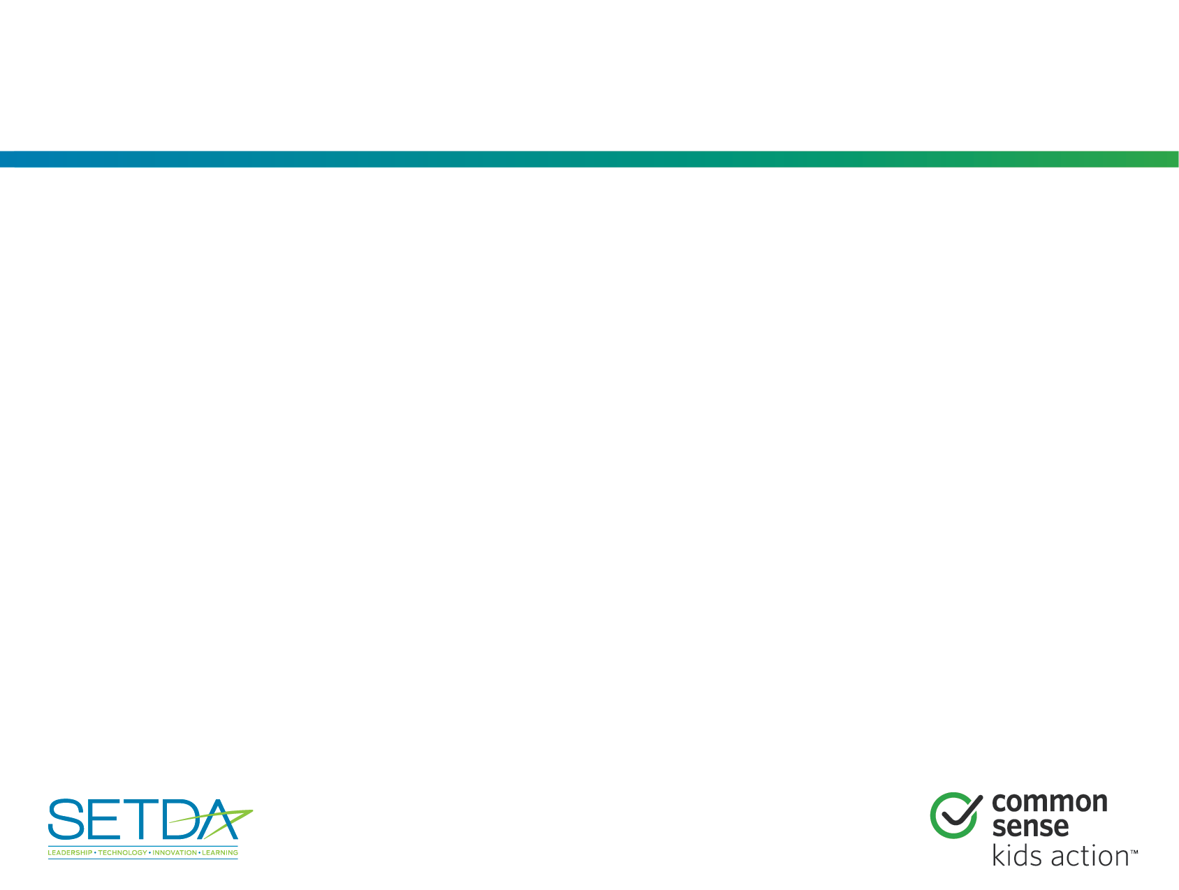
Overview
Thanks to the FCC’s modernization of E-rate in 2014:
  New: Billions of additional dollars are available to help state and local jurisdictions expand broadband and Wi-Fi connectivity in schools/libraries.
  New: The FCC will match up to 10 percent of the state contribution for eligible new broadband construction projects for schools and libraries.
  New: One billion dollars per year available for Wifi
  New: Simplification of application process.
This deck summarizes changes to E-rate and opportunities for policymakers to connect more of your schools/libraries to 21st-century learning tools.

Slide 3
Agenda
The Benefits of Broadband
Understanding E-rate
E-rate Modernization
New State Matching Funds
Expanded Budget for Wi-Fi
Resources

Slide 4
The Benefits of Broadband
21st Century Learning
  Customize and personalize learning
  Enhance career and college ready standards
  Enable 1:1 ed-tech initiatives
  Access high-quality digital content and courses, regardless of geographic location, through distance learning
Teacher Effectiveness
  Real-time tracking of student progress
  More efficient planning and prep requirements
Libraries and schools as technology hubs
  Boost access to education and jobs among local communities.

Slide 5
II. Understanding E-rate
E-rate Overview
Relevant Agencies
E-rate Discounts
Competitive Bidding Requirements
Successes

Slide 6
E-rate Overview
Also called the Universal Service for Schools and Libraries Program.
A federal program designed to connect schools and libraries with modern telecommunications and Internet access services.
    Authorized by the Telecommunications Act of 1996
    Created by the FCC in 1997
    Funded through the Universal Service Fund (USF)
Eligible schools and libraries receive ‘discounts’ on the costs of constructing and maintaining advanced telecommunications.

Slide 7
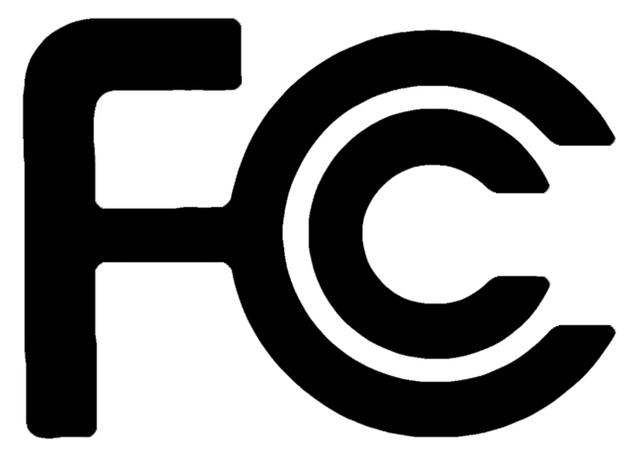

Relevant Agencies
Federal Communications Commission (FCC): The administrator of the Universal Service Fund (a set of telecommunication subsidies and fees used to promote universal service in the U.S.). The FCC writes the rules and standards for programs utilizing the USF.
Universal Service Administrative Company (USAC): An independent, nonprofit corporation designated by the FCC to protect the integrity of the USF. USAC runs the E-rate program, including organizing and approving applications, conducting audits, and providing technical support to state and district E-rate coordinators.

Slide 8
E-rate Discounts
A discount is the percentage of the original cost of a project or service that will be paid for by E-rate. Discounts range from 20% to 90% of project costs.
E-rate discounts are district wide. A school or library’s discount rate is determined by the percentage of students in the district that qualify for free or reduced price lunch.
Rural districts are eligible for an additional 5% to 10% discount compared with urban areas.
Notes:
SETDA/Common Sense suggests putting in state specific discount information into this slide.

Slide 9
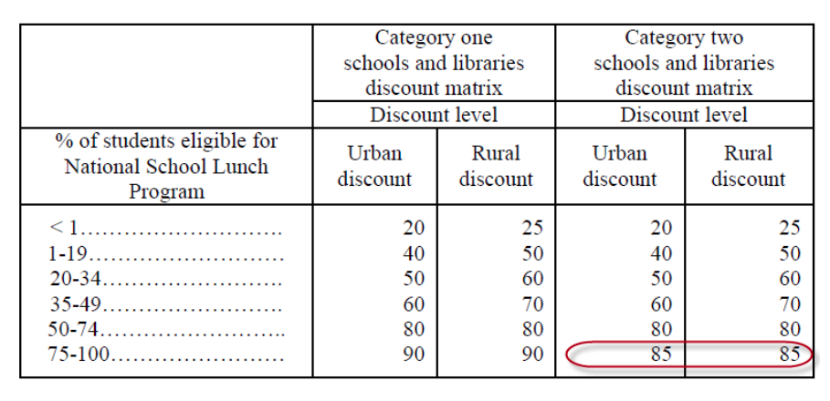
E-rate Discounts
E-rate Discount Calculator
From the FCC’s The E-rate Program: Simplifying Discount Calculations, slide 6.

Slide 10
Competitive Bidding Requirements
Applicants must conduct fair and open competitive bidding process.
Applicants must select the most cost-effective service provider.
Price of eligible products and services must be the most heavily weighted bid evaluation factor.

Slide 11

The Success of E-rate
In 1996, only 14% of classrooms had access to the Internet. Most classrooms with Internet had a low-quality dial-up connection.
By 2005, 94% of all instructional classrooms had a basic Internet connection.

Slide 12
III. E-rate Modernization
Issues with E-rate
Modernization Orders (2014)

Slide 13
Issues with E-rate
E-rate rules and structure were largely untouched from 1996 until 2014. Despite its success, the program suffered from:
Insufficient School/Library Connectivity. 31% of urban schools and 41% of rural schools do not have a basic fiber connection, and 68% of school districts do not have a single school that meets the FCC’s connectivity targets.
Funding Shortages. The structure of the E-rate program prioritized broadband over Wi-Fi connections, making it nearly impossible for schools with lower discount rates to predictably access needed funds.
Notes:
SETDA/Common Sense suggest inserting state-specific data on connectivity shortages.

Slide 14
Modernization Orders (2014)
After extensive public input, the FCC released two modernization orders in 2014 to update E-rate.
  Increased overall E-rate budget to $3.9 bil.
  Set new connectivity targets: 100 Mbps Internet access per 1,000 students and staff (users) in the short term, and 1 Gbps per 1,000 users in the long term.
  Established a dedicated state match for special construction charges, matching new state funding for special construction up to 10% per project on a dollar-to-dollar basis.

Slide 15
IV. New State Matching Funds
Act Now
State Matching Funds
Discount Matrix
Restrictions
Example: New York Bond Initiative

Slide 16
Take Advantage of
State Matching Funds Now
Billions of dollars are available to expand broadband connectivity in local schools/libraries.
Broadband access benefits students, teachers, parents, and communities.
States that fund special construction projects allow schools/libraries to take advantage of FCC match.
To qualify for the match, states must set aside new funds for eligible broadband construction projects.

Slide 17
State Matching Funds
10% dollar-for-dollar match: The FCC will provide eligible applicants with an up to 10% additional discount for special construction charges, matching state funding for the project on a dollar-for-dollar basis.
  For example: A district with a 40% discount can receive up to an additional 10% of E-rate funds if the state provides an additional 10% of the cost of the special construction project.
Tribal schools and libraries: Libraries and schools operated by or receiving funding from the Bureau of Indian Education are eligible for the state match.
Funds are available starting in the 2016 E-rate funding year. (Funding year runs July 1, 2016 through June 30, 2017.)

Slide 18
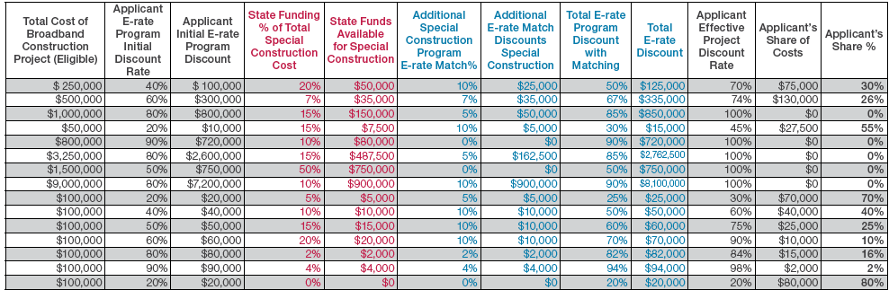
Discount Matrix
Funding Scenarios

Slide 19
Restrictions
Subject to same competitive bidding requirements as other E-rate discounts. Reimbursements will only be provided to the most cost effective solutions.
Only applies to special construction projects. Last mile buildouts, broadband infrastructure.
Designed to encourage new state investments. States are unlikely to receive funds for general state aid.
Eligible projects should provide infrastructure that meets or is scalable to FCC’s broadband capacity targets. 100 Mbps Internet access per 1,000 students and staff (users), short term, 1 Gbps per 1,000 users, long term.
15-year moratorium on match for schools/libraries that build connections using state match. But States can receive other E-rate discounts.

Slide 20

Example: New York Bond Initiative (2014)
Smart Schools Bond Act of 2014: Allows state to sell up to $2 bil. in bonds to finance educational technology and infrastructure in NY schools upon approval by voters. (Approved by voters in 2014.)
  States can purchase “educational technology equipment,” including high-speed broadband infrastructure, using funds.
  Established a “Smart Schools Review Board” to review and approve grants.
Schools are eligible for funds based on formula school aid. Required to submit a “Smart Schools Investment Plan” to outline use of funds.
Notes:
Note: USAC and the FCC have not identified approved state matching examples. All matching funds are subject to FCC approval. If you have questions about eligible funds, please send direct inquiries to: Dana Shaffer FCC, Deputy Managing Director (dana.shaffer@fcc.gov); Charles Eberle, FCC, Attorney Advisor, Wireline Competition Bureau (Charles.Eberle@fcc.gov); or Joe Freddoso, USAC Consultant Dark Fiber (jfreddoso@gmail.com).

Slide 21
V. Expanded Wi-Fi Budget
Modernization Orders set aside $1 billion per year to fulfill Category Two funding requests from FY2015-’19
Maximum discount of 85%
Pre-discount budget of $150 per student for schools and $2.30 per square foot in libraries over a 5-year period
Pre-discount funding floor of $9,200 for eligible schools.
Notes:
SETDA/Common Sense recommend that individual states insert data on Wi-Fi connectivity within their states.

Slide 22
Questions?

Slide 23
VI. Resources
E-rate Resources
Broadband Resources
Definitions
Contact Information
About Us

Slide 24
E-rate Resources
The E-rate Opportunity: http://www.setda.org/priorities/equity-of-access/e-rate-modernization/
FCC’s E-rate Modernization Resources: https://www.fcc.gov/e-rate-update
  Modernization Order Summaries:
  First Modernization Order
  Second Modernization Order
USAC Resources: http://usac.org/default.aspx
  Getting Started
  Glossary of Terms

Slide 25
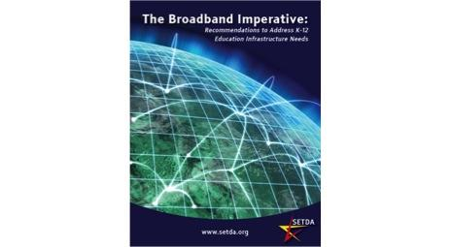
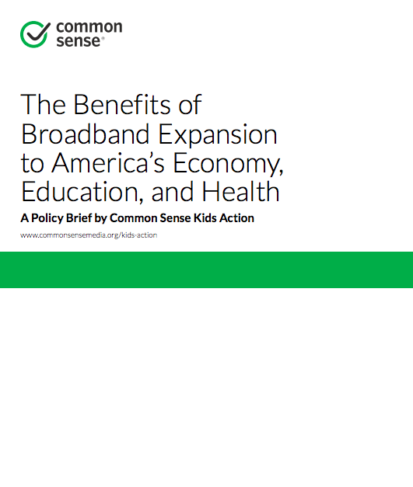
Broadband Resources
http://www.setda.org/priorities/equity-of-access/the-broadband-imperative/
https://www.commonsensemedia.org/about-us/news/press-releases/common-sense-kids-action-releases-new-broadband-policy-brief

Slide 26
Definitions
Broadband: High-speed Internet access. Broadband includes several high-speed transmission technologies including: Digital Subscriber Lines (DSL); Cable Modem; Fiber; Wireless; Satellite; and Broadband Over Powerlines.
Last Mile/Wide Area Network (WAN): School districts and library systems frequently connect individual schools and libraries at a central aggregation point, such as a district, county, or regional data hub. We refer to these connections as “last mile” or Wide Area Network (WAN) connections.
E-rate Special Construction: The upfront cost of deploying new facilities (typically fiber), in contrast to the recurring cost of having access to facilities.
Fiber: Fiber optic technology converts electrical signals carrying data into pulses of light and sends them through transparent glass fibers about the diameter of a human hair. A “fiber build” refers to constructing the glass fibers that will provide Internet access.
Internet Access: School districts and some library systems purchase Internet access for the entire district or system at a single point of aggregation. “Internet access” is the connection or connections that allow traffic to flow from that aggregation point to the public Internet.
Notes:
Individual presenters should add/take away definitions as they see fit--keeping in mind that USAC has a full glossary: http://www.usac.org/_res/documents/sl/pdf/handouts/SL-Glossary-of-Terms.pdf

Slide 27
Contact Information
[Insert State Contact]
FCC Contacts:
  Dana Shaffer, Deputy Managing Director (dana.shaffer@fcc.gov)
  Charles Eberle, Attorney Advisor, Wireline Competition Bureau (Charles.Eberle@fcc.gov)
  Joe Freddoso, Dark Fiber Consultant - USAC (jfreddoso@gmail.com)
Christine Fox, Director of Educational Leadership and Research, SETDA (cfox@setda.org)
Susannah Savage, Honors Policy Associate, Common Sense Kids Action (ssavage@commonsense.org)

Slide 28
About Us
SETDA and Common Sense Kids Action are working together to help finish the job of connecting all classrooms and libraries to the Internet by 2018.
Founded in 2001, the State Educational Technology Directors Association (SETDA) is the principal nonprofit membership association representing US state and territorial educational technology leaders. Our mission is to build and increase the capacity of state and national leaders to improve education through technology policy and practice. setda.org
Common Sense Kids Action works with policy makers, business leaders, and other advocates to ensure that every child has the opportunity to succeed in the 21st century. Our mission is to make kids and education our nation's top priority by building a membership base and driving policies that promote access for all kids to 21st-century schools, protect their online privacy, invest in early childhood supports, and reduce child poverty. https://commonsensemedia.org/kids-action

