Slide 2
Agenda
Welcome & Introductions
Christine Fox, SETDA
Quality Instructional Materials Background
Christine Fox, SETDA
State Perspective
Alan Griffin, Utah State Office of Education
Barbara Soots, Washington Department of Public Instruction
Quality Instructional Materials for Learning Tool Overview
Christine Fox, SETDA
Q and A
Facilitated by Christine Fox, SETDA

Slide 3
About SETDA
SETDA is a 15 year old non-profit that serves, supports, and represents U.S. state digital learning leaders.
Mission is to build and increase the capacity of state and national leaders to improve education through technology policy and practice.
Forum for:
Advocacy for policy and practice
Professional learning
Inter-state collaboration
Public-private partnerships
State - federal relations

Slide 4
Tools and Resources
SETDA has a track record of advocacy for digital learning:
Digital Instructional Materials Acquisition Policies Portal (updates spring 2017 – launch 2015 )
Navigating the Digital Shift 2015
Digital Content Policy Briefs 2014-2015
Out of Print Report 2012
Broadband Imperative II 2016
State K-12 Broadband Leadership 2016
E-rate Modernization Toolkit 2015
Broadband Imperative 2012
Notes:
SETDA is the principle association serving state leaders focused on the transition to digital learning – our mission is to build the capacity of state and national leaders to improve education through technology.

Slide 6
Thank You

Slide 7
Rationale
Based on requests from state leaders, the Guide to Quality Instructional Materials supports the ability to establish or enhance state level review processes and to provide guidance to districts.
This guide may be used to:
Provide guidance to schools, districts and states regarding the selection of instructional materials
Inform instructional materials adoption policies and ongoing review processes at the state level
Encourage state leadership as related to instructional materials selection and procurement
Inform the private sector with an outline of considerations regarding the instructional materials selection and adoption process
Share resources for a variety of stakeholders involved in the process of selecting instructional materials

Slide 8
Project Background
Taskforce: state and district leaders and private sector partners
In-Person Focus groups Interviews with state procurement officers
Online Collaboration
Independent research
External Reviewers: CCSSO, SIMRA, CAST

Slide 9
Special Thank You
Taskforce Members
Taskforce Chairs
Kurt Bernhardt, Executive Director of Education Technology, Oklahoma State Department of Education
Barbara Soots, Washington State Department of Public Instruction
Co-Author Rachel Jones, Educational Consultant

Slide 10
What is Quality ?
SETDA Definition
Quality instructional materials are content-rich materials, aligned to standards that are fully accessible and free from bias. They support sound pedagogy and balanced assessment to help teachers understand and interpret student performance.
Quality Instructional Materials must be:
Aligned to state, district, and building learning standards as measured by widely-accepted evaluation tools.
Current, relevant, and accurate content that is user friendly, fully accessible for all learners, and free from bias
.

Slide 11
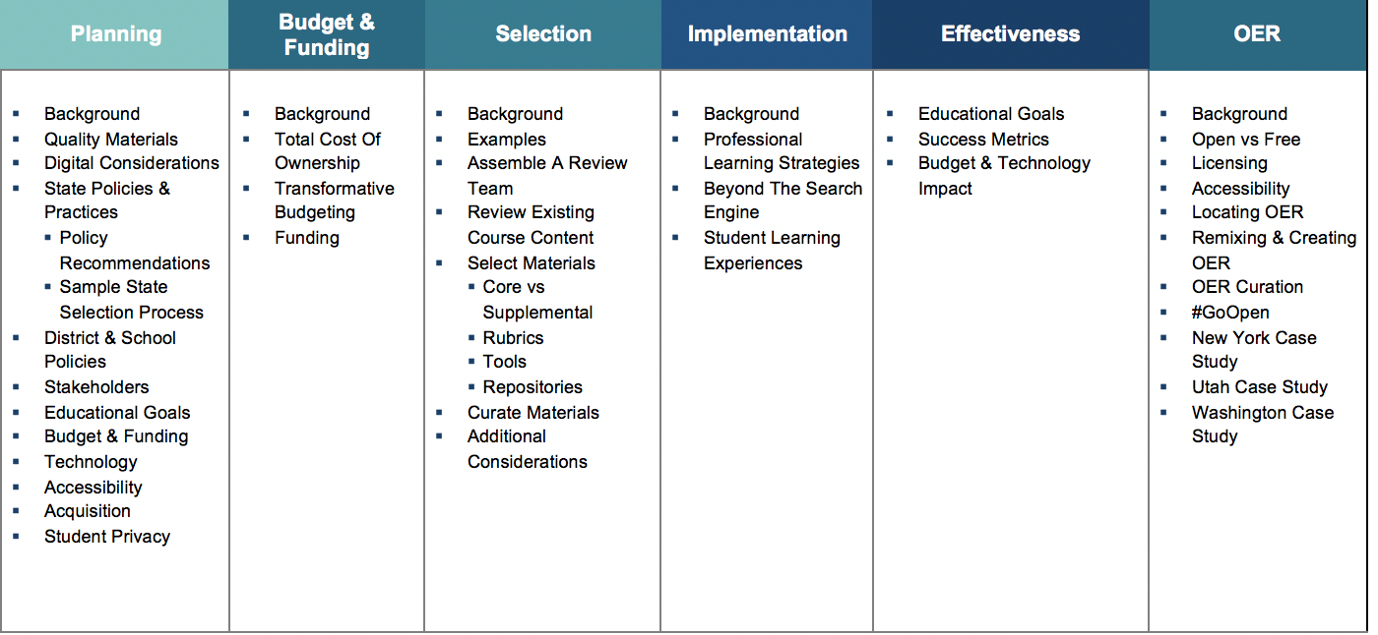
Topics & SubTopics

Slide 12
Need for State Leadership
Vision
Leadership
Guidance
Professional Learning
Assessment and Evaluation

Slide 13
Sustained Support
Join the online community
Essential Elements for Digital Content
http://www.edweb.net/digitalcontent

Slide 14
Site Walk Through
http://qualitycontent.setda.org

Slide 15
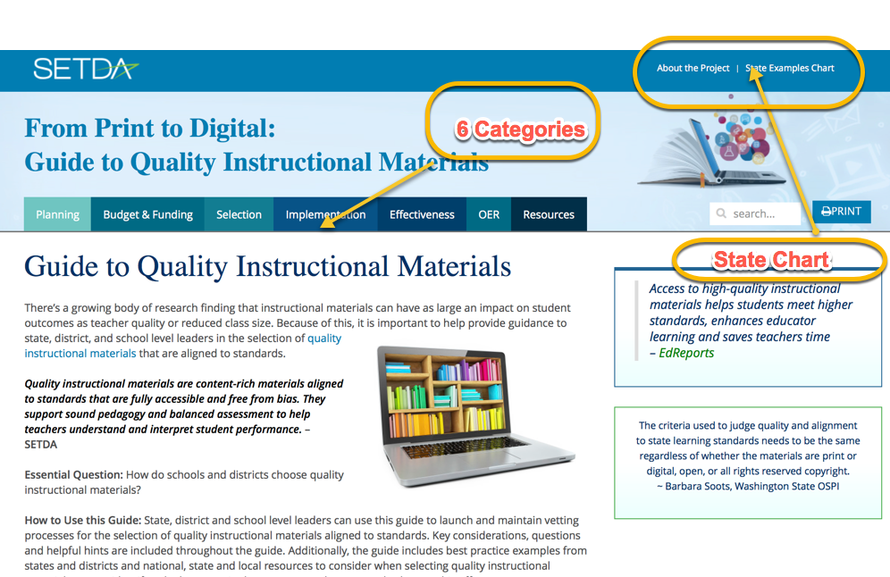
Home Page

Slide 16
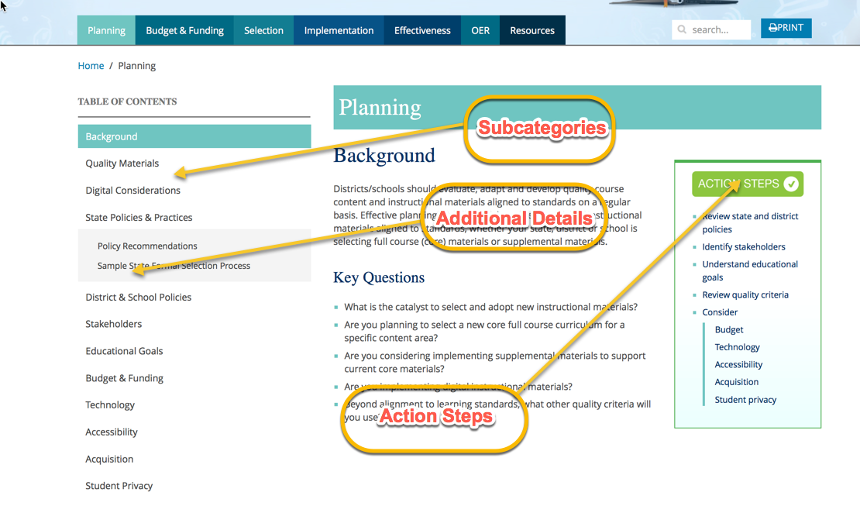
Subcategories & Action Steps

Slide 17
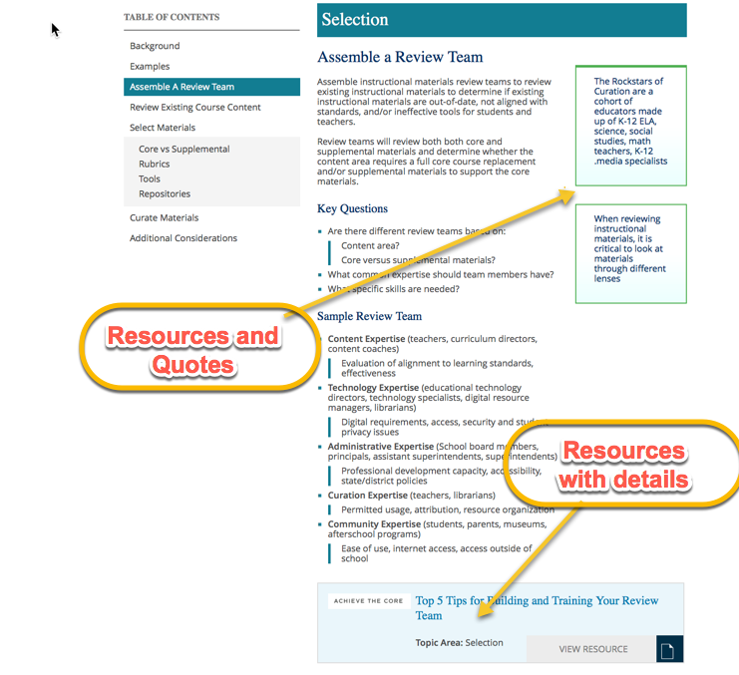
Embedded Resources

Slide 18
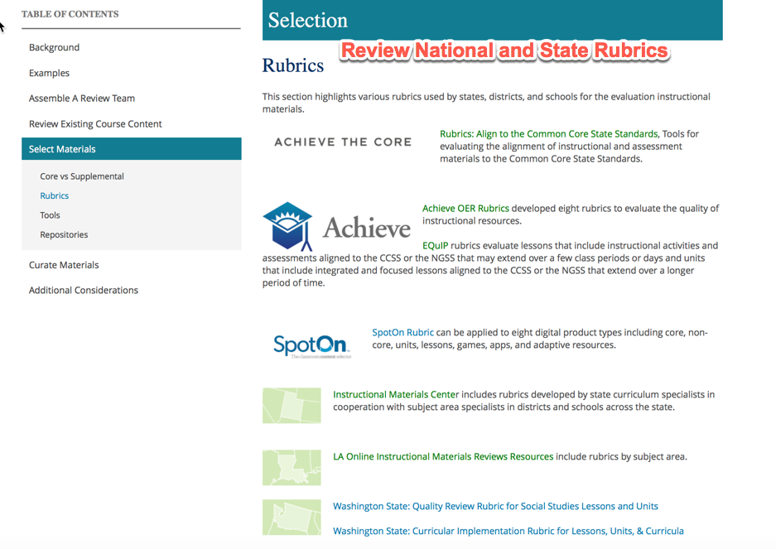
Comprehensive Access to Rubrics/Tools

Slide 19
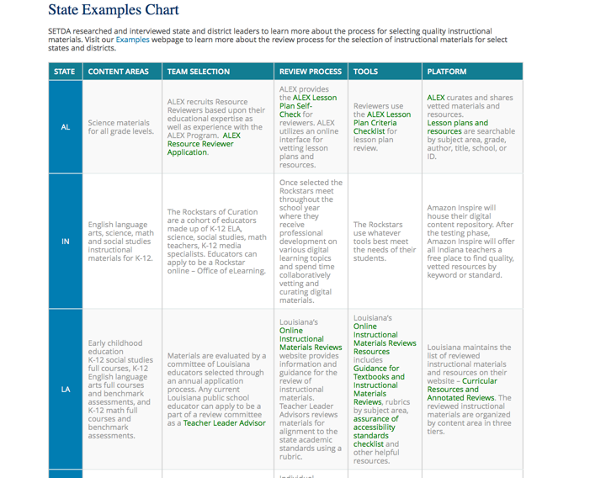
Snapshot – State Review Processes Chart http://qualitycontent.setda.org/summary/

Slide 20
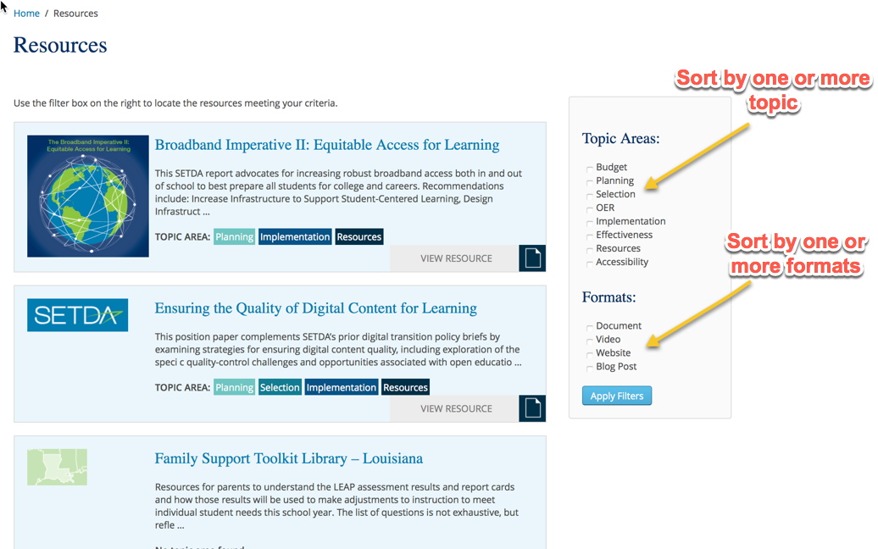
Resources Bank

Slide 21
Continue the Conversation
Join the online community
Essential Elements for Digital Content
http://www.edweb.net/digitalcontent
Follow @SETDA on Twitter

