Slide 1
Free Textbook Project
Tracy Poulsen

Slide 2
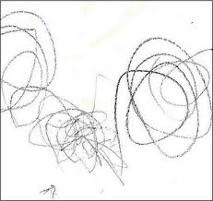
Notes:
What’s similar about these pictures?
Which one is personally more valuable to you / me?
**These are both copyrighted.

Slide 3
Copyright…friend or foe?
Teachers have a bit more flexibility with copyright for instructional purposes
…but this doesn’t mean we can do whatever we want with material we find on the internet or that we receive with our publishers’ textbooks.
Notes:
Identify situations in which teachers (or others) have violated copyright. Example: Bozeman Science on Youtube

Slide 4
What are OERs?
“Teaching, learning and research materials in any medium, digital or otherwise, that reside in the public domain or have been released under an open license that permits no-cost access, use, adaptation and redistribution by others with no or limited restrictions.” (UNESCO, 2002)
Open = copyright allows us to use, distribute, (frequently) modify, etc. without violating copyright
Educational = designed for education
Resources = text / books, videos, music, etc.

Slide 5
What is the Utah OER project?
The USOE Science Curriculum Department has worked with teachers to create OER textbook to be used by teachers within the state, covering science grades 3-12.
This book has Utah’s curriculum all in one book, leaving nothing out and including very little additional material
Free!
Digital version is free to teachers, students, parents, etc.
Printed version is less than $5 per book
Notes:
The state OER plan
the state put it together
you can adapt it as a department / team / etc
you adapt it to fit your teaching (you don’t teach exactly the same as another teacher, even if you are using the same materials, and collaborate to make the same materials – Mom & I)

Slide 6
Making it your own
Flexible
Copyright gives teachers the ability to edit, alter, and use any of this content without worry of violating copyright
Teachers can customize the book to fit their own teaching needs and style…as long as you use creative commons copyrighted materials and distribute it with the same copyright
Notes:
We all have our “favorites” that we teach regardless of what we’ve been given. The OER provides us with resource for all the core content – some of it skimpier than you would originally plan (your favorites) and beefier on some things that aren’t your favorite. We can take this book and customize it to fit our own teaching.
On “bring picture of something”… (Brian’s image from Holt Biology book)
Do a glue-in with one of Tracy’s images

Slide 7
Making it your own
But the state’s book is currently available in pdf. This is not very editable.
With OER materials, you have the right to:
Print only specific sections / pages / etc.
Cross out pages
Bring picture from something you have legal rights to distribute to your students (from paid for publisher book, as long as you don’t post it online)
Add something that you personally have written / drawn / etc. & put that in there

Slide 8
Discussion
Think of a tool / resource / image that you especially like to use.
Do you have legal rights to use it? Can you…
Post it on your website?
Photocopy it and distribute it to your students?
Change it to fit how you teach a topic?

Slide 9
Finding Creative Commons Materials
Creative Commons materials include images, texts, etc., that have been licensed giving others the ability to either use, distribution, or modify (depending on the exact license)
Options for finding creative common licensed materials:
Search.creativecommons.org
Advanced search options in Google search
www.ck12.org (math & science grades 6-12)
www.thunderboltkids.co.za/ (science grades 4-6)

Slide 10
Discussion
Discuss with your table how you use a science textbook in your classroom.
Be prepared to share some ways it supports your teaching with the larger group.
What do you want to be able to do with your textbook? What’s stopping you?

Slide 11
Notes:
How is this similar to our students?
Now you have a book…but do your kids know how to use it?

Slide 12
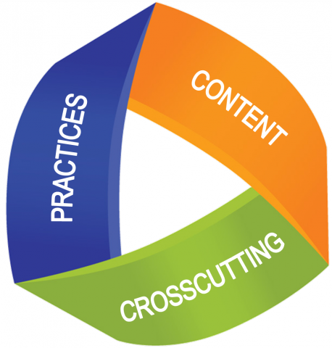
Where are we going in science instruction?
The new science standards which are currently being written for grades 6-8 and will be written for the other grades in the upcoming years are based on a three dimensional framework.
(NGSS - http://www.nextgenscience.org/three-dimensions)

Slide 13
Literacy Strategy
(Give a specific passage here)
As you read this passage, look for the causes and effects of the phenomenon.
Highlight the “causes” in red and the “effects” in blue
Other graphic organizers and literacy strategies: http://www.schools.utah.gov/CURR/science/OER.aspx
Notes:
Which book (OER / traditional) was more effective to use to teach this literacy strategy?

Slide 14
What instructional goals did we accomplish with our reading activity?
Science content (disciplinary core ideas in the new framework; core curriculum in the current standards)
Cause-Effect relationships in science (one of the cross-cutting concepts in the new framework; ILO’s in the current standards)
We can’t forget that we are also responsible for ELA standards and math standards
By integrating effective reading strategies we are creating better learners, targeting our science standards (current and new framework) and ELA standards (for which every subject is accountable)

Slide 16
Literacy strategies – Structural patterns in expository texts
Identifying the structural pattern in a passage of text can help students identify main ideas in what they are reading.
Some patterns include:
Cause / Effect
Compare / Contrast
Sequential (chronological)
Problem / Solution
Description / Information

Slide 17
Compare / Contrast
(Give participants a passage to analyze)
(Give handout for compare / contrast)
How did you know this passage was compare/contrast? (What key words signaled that this type of structure was present)?
As you read, highlight the properties of X in red, Y in yellow, and things they have in common in orange.
Use this information to construct a Venn diagram of what you read.
What content do you teach is probably written in your textbook with this pattern?

Slide 18
Sequential / Chronological
(Give participants a passage to analyze)
(Give handout for sequential)
How did you know this passage was sequential? (What key words signaled that this type of structure was present)?
As you read, number the events in the order in which they occur.
Use this information to construct a timeline of what you read.

Slide 19
Problem / Solution
(Give participants a passage to analyze)
(Give handout for problem / solution)
How did you know this passage had a problem/solution structure? (What key words signaled that this type of structure was present)?
As you read, highlight the problems in blue and the solutions to the problems in yellow.
Use this information to complete the graphic organizer
Problem
Problem
Problem
Solution

Slide 20
Reading with a Purpose
Read questions (teacher’s or author’s) to know what you are looking for in your reading
Read objectives before you read the section
Notes:
Example of reading with a purpose: Brian’s reading questions

Slide 21
Reading Comprehension (Summary Protocol)
In groups of 2-3 students, each person silently reads one paragraph of text.
When each person is done, discuss what the paragraph was about. Each person must contribute something to the discussion.
Come to a consensus about the 1-2 main ideas of the paragraph and how they should be worded. Each person writes the main idea in their own book.
Continue with the next paragraph
Notes:
Summary protocol (Arthur Beauchamp): (See https://sites.google.com/site/scienceliteracystrategies/receptive-language-literacy-skills-comprehension/summary-protocol)

Slide 22
Revisit: What does a good science classroom look like?
Not only is it “hands-on”, “student-centered”, etc., literacy instruction is a piece of what you do with kids in good instruction.

Slide 23
More Information
To buy / download the USOE books: http://www.schools.utah.gov/CURR/science/OER.aspx
tracy.poulsen@nebo.edu

