Slide 1
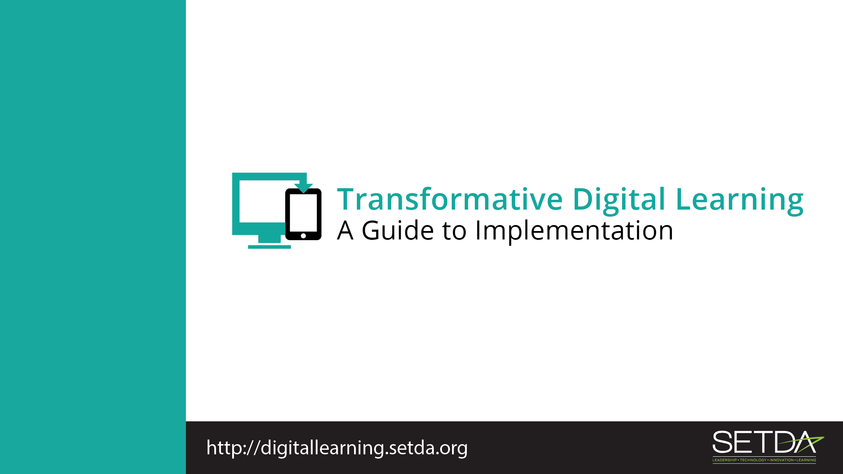
Students

Slide 2
Learning in the Digital Age
Technology is an essential component of learning today.
Students can
  Create content
  Interact with experts
  Collaborate with peers

Slide 3
Federal Policy Shift
Every Student Succeeds Act (ESSA) acknowledges technology’s role in revolutionizing learning
  Includes definitions for digital learning and blended learning
  References technology throughout the legislation
Notes:
S

Slide 4
Federal Policy Shift
National Education Technology Plan (NETP) calls for a “revolutionary transformation rather than evolutionary tinkering”
  Provide engaging and powerful learning experiences by leveraging technology
Notes:
Refer to Stakeholder toolkit, page 1-2.

Slide 5
Federal Policy Guidance
High-quality professional development to personalize learning and improve academic achievement
Build technological capacity and infrastructure
Innovative blended learning projects
Provide students in rural, remote, and underserved areas with the resources to benefit from high-quality digital learning opportunities
Deliver specialized or rigorous academic courses and curricula using technology, including digital learning technologies
Non-Regulatory Guidance Student Support and Academic Enrichment Grants Overview of Activities LEAs May Consider
Notes:
Refer to Stakeholder toolkit, page 1-2.

Slide 6

Transforming Digital Learning
Notes:
Transforming Digital Learning
Students in Black Hawk elementary school in South Dakota shows Transforming Digital Learning. https://www.youtube.com/watch?v=NyjsC1x5T54

Slide 7
Role of Students
Speak Up 2016 reports that students are using mobile devices for a variety of teacher-directed and student directed activities.
  81% doing internet research
  39% taking notes
Technology is gateway to:
  Personalizing and self-blending learning
  Academic and/or career preparation purposes
Notes:
Refer to Stakeholder toolkit, Role of School Libraries, page 2-3.

Slide 8
Digital Citizenship
As a student, how can I learn more about my digital footprint?
Librarians, teachers, parents
Digital Footprint
Middle School Digital Citizenship Videos
Notes:
Refer to Stakeholder toolkit, page 4. These are sample questions to engage stakeholders. Feel free to modify to meet our needs.

Slide 9
Homework Gap
My teacher assigns homework that requires access to the internet. How can I access the internet outside of my home?
Check out a hot spot from your school to take home
Visit the public library for access to the internet, devices and digital resources
Utilize your extended school library hours
Notes:
Refer to Stakeholder toolkit, page 4. These are sample questions to engage stakeholders. Feel free to modify to meet our needs.

Slide 10
Resources
Common Sense Education Cyberbullying and Digital Footprint
U.S Department of Health and Human Services Cyberbullying
Middle School Digital Citizenship Videos
High School Digital Citizenship Videos
Safe and Secure Online
Protecting Equity through Family-School Partnerships
FCC Lifeline Program

Slide 11
Thank You!
Learn more at:
Transforming Digital Learning: Toolkit to Support Educators and Stakeholders

