Slide 1
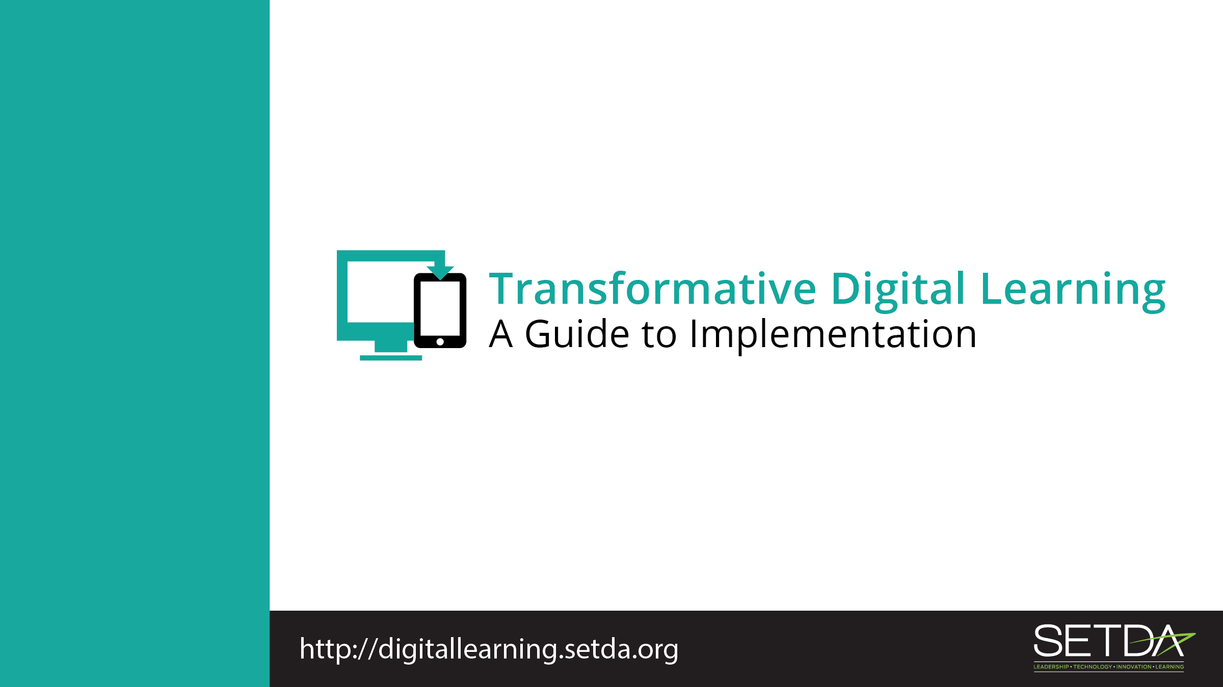
School Librarians

Slide 2
Learning in the Digital Age
Technology is an essential component of learning today.
Students can
  Create content
  Interact with experts
  Collaborate with peers

Slide 3
Federal Policy Shift
Every Student Succeeds Act (ESSA) acknowledges technology’s role in revolutionizing learning
  Includes definitions for digital learning and blended learning
  References technology throughout the legislation
Notes:
S

Slide 4
Federal Policy Shift
National Education Technology Plan (NETP) calls for a “revolutionary transformation rather than evolutionary tinkering”
  Provide engaging and powerful learning experiences by leveraging technology
Notes:
Refer to Stakeholder toolkit, page 1-2.

Slide 5
Federal Policy Guidance
High-quality professional development to personalize learning and improve academic achievement
Build technological capacity and infrastructure
Innovative blended learning projects
Provide students in rural, remote, and underserved areas with the resources to benefit from high-quality digital learning opportunities
Deliver specialized or rigorous academic courses and curricula using technology, including digital learning technologies
Non-Regulatory Guidance Student Support and Academic Enrichment Grants Overview of Activities LEAs May Consider
Notes:
Refer to Stakeholder toolkit, page 1-2.

Slide 6

What Do You Predict for the Future?
Notes:
Librarian Sereena Hamm of Washington Latin Public Charter School discusses her thoughts for libraries in the future.
Refer to Stakeholder toolkit, Transforming Digital Learning, page 5.

Slide 7
School Libraries
Offer a space for students to create content and collaborate
Provide access to the internet and digital resources
Notes:
Refer to Stakeholder toolkit, Role of School Libraries, page 2-3.

Slide 8
Role of School Librarians
Teach students
  Information literacy skills
  Use of digital tools and applications
  Digital citizenship
Collaborate with classroom teachers and fellow educators
Model digital learning instruction
Notes:
Refer to Stakeholder toolkit, Role of School Libraries, page 2-3.

Slide 9

Professional Learning
Our school is now completely digital for instructional materials. How can I help teachers effectively utilize these materials?
School librarians in the digital age can help teachers locate digital instructional materials and resources
2011 School Library Research survey states that 74% of respondents were either fully or partially involved in “collaborating with teachers to use technology in their instruction”
Notes:
Refer to Stakeholder toolkit, page 3. These are sample questions to engage stakeholders. Feel free to modify to meet our needs

Slide 10
Digital Citizenship
How can school librarians support students around digital citizenship?
School librarians are an excellent resource for teachers and students on how to use technology safely and responsibly
School librarians can help students with information literacy – the ability to find, evaluate, interpret, and apply information
Encourage collaboration and creation of content
Help navigate cyberbullying, internet safety, and other digital concerns.
Notes:
Refer to Stakeholder toolkit, page 4. These are sample questions to engage stakeholders. Feel free to modify to meet our needs.

Slide 11

Community Partnerships
How can the school librarian create awareness about digital learning in their school or district?
Advocate for digital learning as they work with principals, teachers and students
Generate public and parental support for digital learning
Invite parents to tour the school library to see the digital tools and resources
Notes:
Refer to Stakeholder toolkit, page 4. These are sample questions to engage stakeholders. Feel free to modify to meet our needs.

Slide 12
Thank You!
Learn more at:
Transforming Digital Learning: Toolkit to Support Educators and Stakeholders

