Slide 1
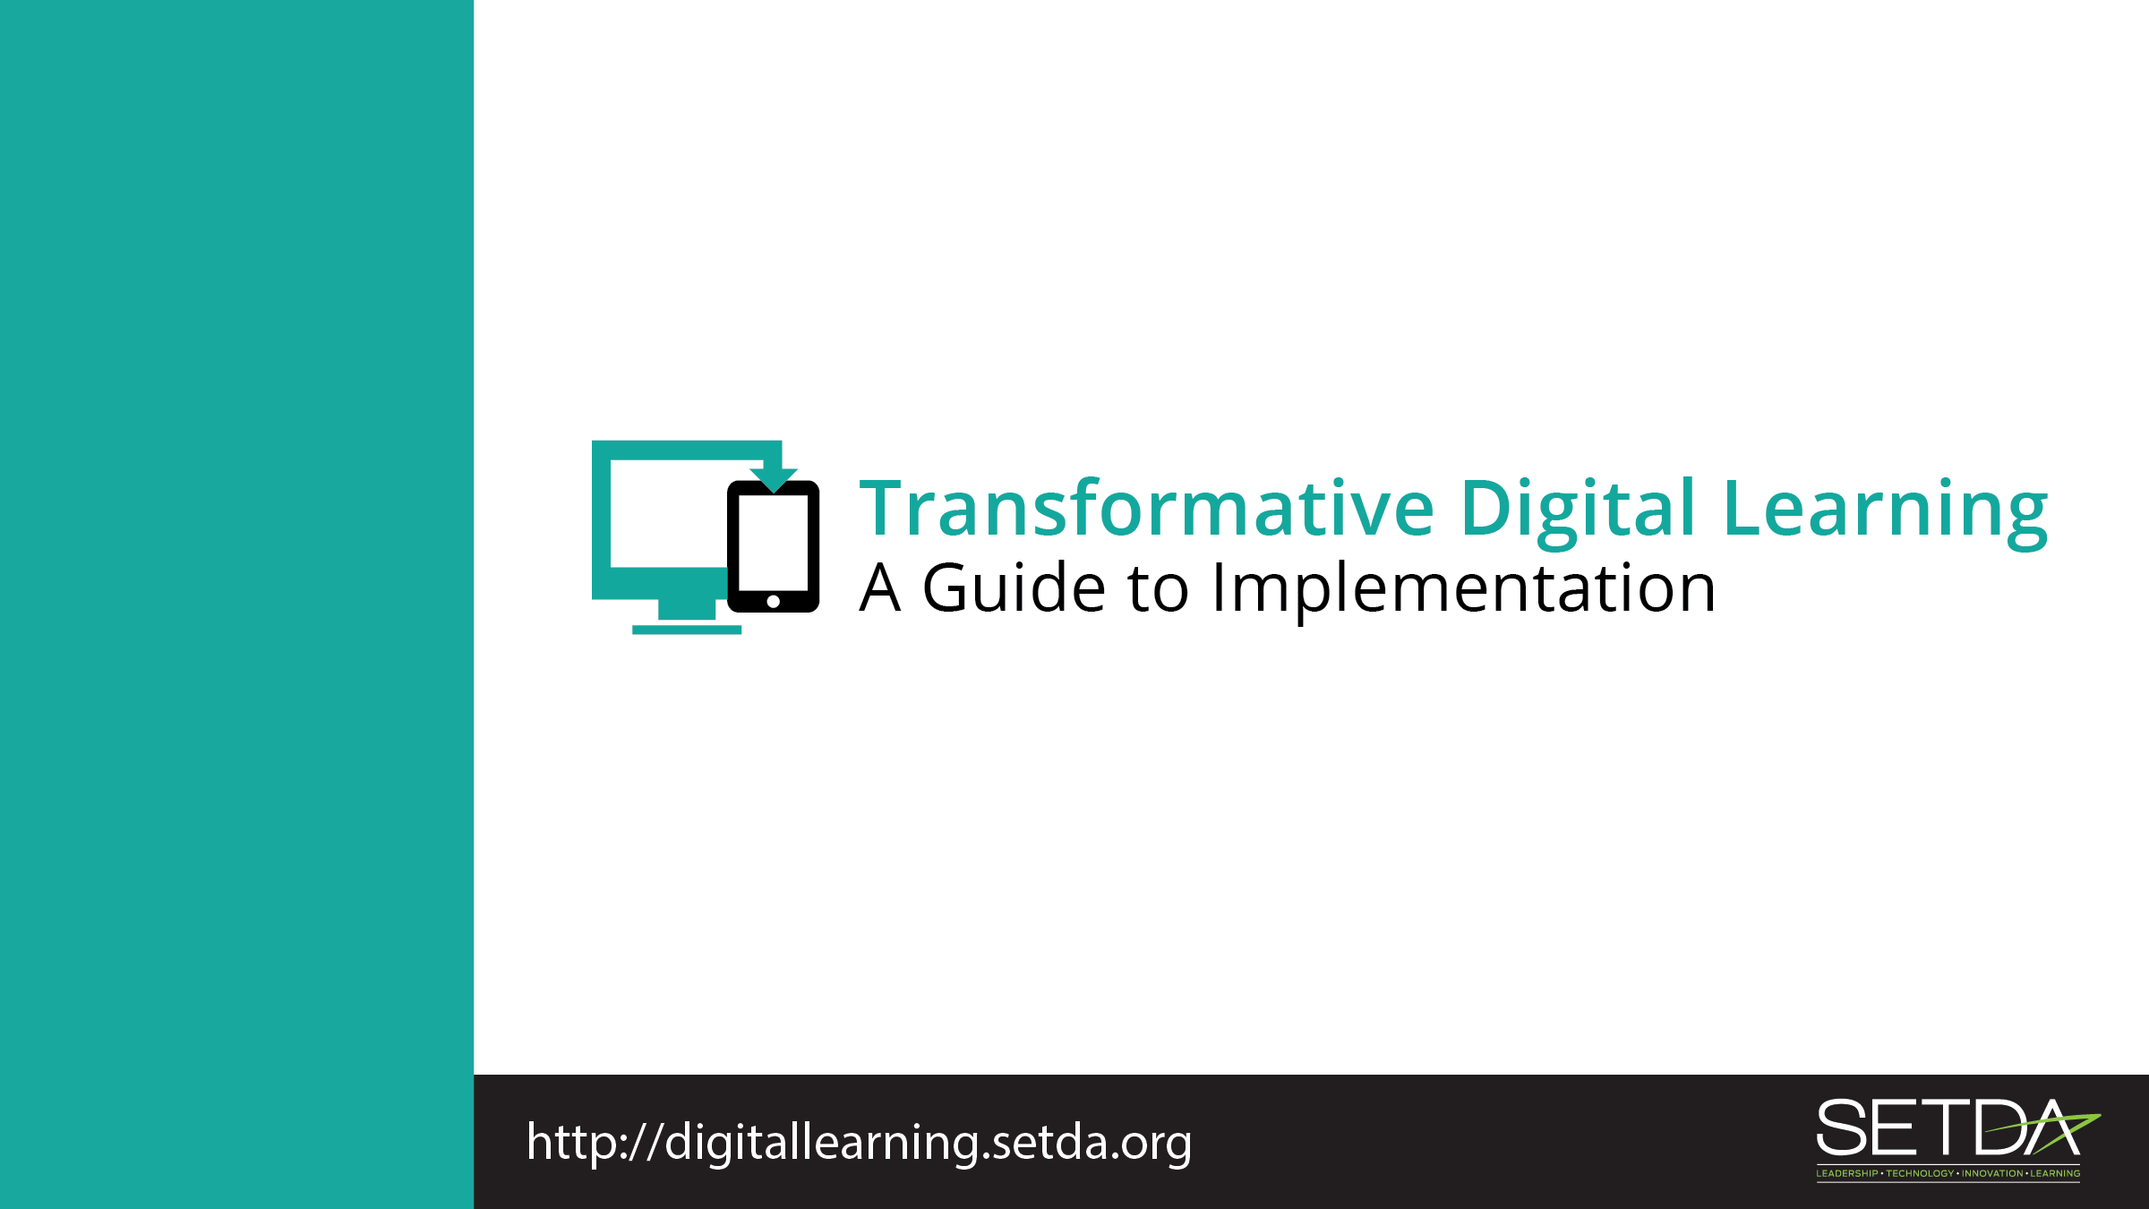
Parents

Slide 2
Learning in the Digital Age
Technology is an essential component of learning today.
Students can
  Create content
  Interact with experts
  Collaborate with peers

Slide 3
Federal Policy Shift
Every Student Succeeds Act (ESSA) acknowledges technology’s role in revolutionizing learning
  Includes definitions for digital learning and blended learning
  References technology throughout the legislation
Notes:
S

Slide 4
Federal Policy Shift
National Education Technology Plan (NETP) calls for a “revolutionary transformation rather than evolutionary tinkering”
  Provide engaging and powerful learning experiences by leveraging technology
Notes:
Refer to Stakeholder toolkit, page 1-2.

Slide 5
Federal Policy Guidance
High-quality professional development to personalize learning and improve academic achievement
Build technological capacity and infrastructure
Innovative blended learning projects
Provide students in rural, remote, and underserved areas with the resources to benefit from high-quality digital learning opportunities
Deliver specialized or rigorous academic courses and curricula using technology, including digital learning technologies
Non-Regulatory Guidance Student Support and Academic Enrichment Grants Overview of Activities LEAs May Consider
Notes:
Refer to Stakeholder toolkit, page 1-2.

Slide 6
Role of Parents
Seek information from district and school leaders
Understand new learning models

Slide 7
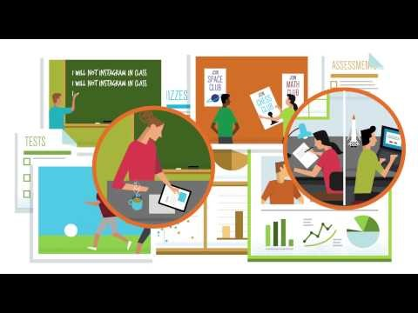
What is Student Data?
Notes:
What is Student Data? In this short video, learn more about how student data can empower parents, students, educators and policymakers. There are many types of data that support student learning. The video shows the types of data that can come together—under requirements like privacy and security—to form a full picture of student learning. https://www.youtube.com/watch?v=3g4ifVVf-RI
Refer to stakeholder toolkit, Transforming Digital Learning, page 5.

Slide 8
Instructional Materials
I don’t know what online resources to choose to help my children with homework. When I search the internet, there are so many choices.
List of vetted or approved digital tools from district or school
Seek school and teacher input
Active use of technology - creation, production and problem solving
Look for digital tools that include third-party research that proves efficacy.

Slide 9
Digital Citizenship
How do I know that my child knows how to use the internet and digital resources responsibly? What resources are available for parents?
Cyberbullying
Digital Footprint
U.S Department of Health and Human Services Cyberbullying
How to be a Good Digital Parent Toolkit
Safe and Secure Online

Slide 10
Homework Gap
My child requires access to the internet outside of school. Our internet is slow and unreliable. What can we do?
Check out the FCC Lifeline program
Visit the public library for access to the internet, devices and digital resources
Utilize your extended school library hours

Slide 11
Student Data Privacy & Security
I am worried about who has access to my child’s information and how it might be used. What measures are in place to ensure that information is protected?
Family Educational Rights and Privacy Act (FERPA) provides parents with certain protections regarding their children's education records, and the
Children's Online Privacy Protection Act (COPPA) protects the privacy of children under 13.

Slide 12
Thank You!
Learn more at:
Transforming Digital Learning: Toolkit to Support Educators and Stakeholders

