Slide 1
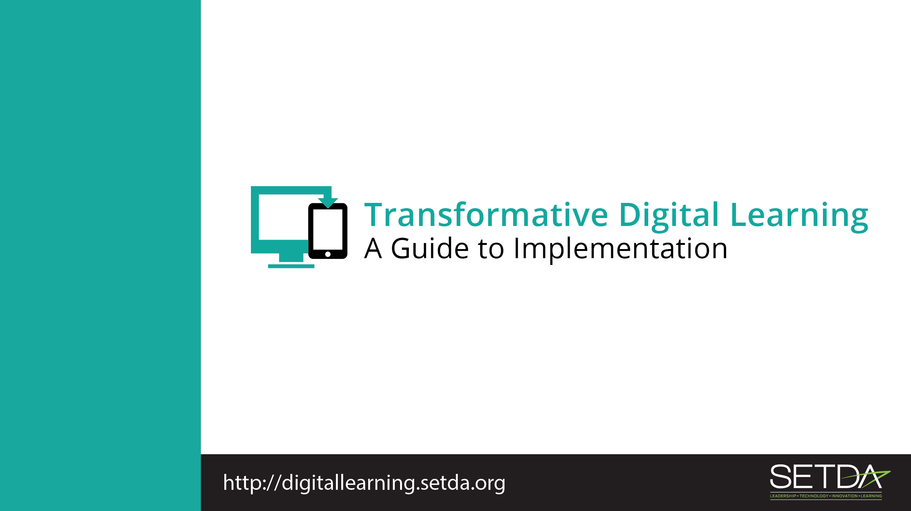
Student Data & Privacy

Slide 2
Session Overview
Welcome & Introductions
Background
Exemplar Rapid Fire Presentations
Policies
Establishing a Student Data Privacy Program
Strengths & Challenges
Parent Engagement
Reflection & Wrap-Up
Notes:
Introduce yourself, review the key sections and any logistics for the session.

Slide 3

Purpose of the Workshop
Opportunity to check in and discuss current student data privacy practices
To identify areas for improvement.
Notes:
Refer to FG, Page 1-2.

Slide 4
Objectives
Learn more about data privacy
Collaborate with colleagues to learn the current status of privacy programs
Assess the strengths and challenges of your school’s privacy program
Explore ways to engage parents
Acquire resources supporting student data privacy
Develop and maintain relationships with other district and state leaders
Notes:
Refer to FG, Page 1-2.

Slide 5

What is Important to You?
Personal Data Inventory
Share your name, title, school or district and how many different online accounts you personally have for the following:
  Social Media
  Personal Finances
  Work Place
  Email
Notes:
Introduce the welcome activity to help you better understand who is in the audience and to get participants engaged.
Refer to FG, Welcome Activity, page 2 for activity instructions

Slide 6
Overview
National Education Technology Plan
Use of student data is crucial for personalized learning and continuous improvement
Consider how data privacy, confidentiality, and security practices affect students
Notes:
Refer to FG, Best Practices

Slide 7
Overview
Students and parents understand their rights and responsibilities concerning data collection
District policies regarding who has access to student data
District policy for reviewing third party agreements
Notes:
Refer to FG, Best Practices

Slide 8
Privacy Technical Assistance Center
“One-stop” resource for education stakeholders
Learn about data privacy, confidentiality, and security practices
Resources include training materials and direct assistance

Slide 9
Protecting Student Privacy
Notes:
Refer to FG, Background. Video
PTAC’s Protecting Student Privacy Training Video

Slide 10
Discussion Questions
What does transparency mean to you, with regard to educational technology, privacy, and parents?
How transparent is your district with regard to student data collected by the school or third parties (e.g., online educational service providers)?

Slide 11
Exemplar Rapid Fire Presentations
Add presenter name, district/school
Discussion Questions
How is your school/district similar to the exemplar?
Are there practices shared that your school/district can implement within the next quarter?
Notes:
Ask one or two exemplar schools/districts to share their background and experience. The presentations should be 5-7 minutes and prepared in advance of the workshop. Additional information about presentations can be found in the Logistics resource.
Refer to FG, page 4. You can also refer to the Logistics Resource for tips

Slide 12
Federal Policies
Family Educational Rights and Privacy Act Affords parents the right to
Inspect and review their children’s education records
Seek to have the education records amended
Control over the disclosure of personally identifiable information
The Protection of Pupil Rights Amendment
Governs the administration to students of a survey, analysis, or evaluation that reveals information concerning one or more of eight protected areas

Slide 13
Federal Policies
Children’s Online Privacy Protection Act (COPPA) (15 U.S.C. § 6501–6505) governs online collection of personal information from children under age 13.
Children’s Internet Protection Act (CIPA) (47 U.S.C. § 254) requirements on schools or libraries that receive E-rate discounts for internet access.
Certify that they have an internet safety policy
Protection measures must block or filter internet access to pictures that are obscene, pornographic, or harmful to minors
Monitor online activities of minors.
IDEA also provides confidentiality protections and often additionally will protect information for students with disabilities.

Slide 14
State Policies
Many states have student data privacy legislation
Review your state laws for updates and additional laws on student data privacy
National Conference of State Legislatures has up to date information http://www.ncsl.org/research/education/student-data-privacy.aspx

Slide 15
Developing a Privacy Program
What do you know about your school’s privacy program?
Do you know what your state student privacy statute requires?
Do your students and families understand their rights and responsibilities concerning data collection?
How are you protecting your students and families?
Does your district have policies or procedures in place for reviewing third party agreements for compliance around use, protection (data security) and destruction of student personally identifiable data?
Notes:
Refer to FG, page 6. Share the video and then discuss using questions
PTAC’s Developing a Privacy Program
The video addresses the legal and ethical requirements for student data privacy. It also discusses transparency requirements.
https://youtu.be/clcJ_6n2qPA

Slide 16
Strengths & Challenges
How is your school/district incorporating educational technology into the privacy program?
What are your greatest strengths in protecting student privacy when using educational technology?
What are areas of growth?
How do you inform staff about changes in privacy policies?
Do you offer annual training for new staff? If not, how would you go about setting one up?
How is privacy information communicated to students?
Notes:
Refer to FG, page 6 for activity instructions

Slide 17
Parent Engagement
How are parents involved in your school or district’s privacy program?
How are parents informed about technology that collects data about their children?
How can you improve communication with parents about student data?
Notes:
Refer to FG, page 7. Share the video
PTAC’s What Parents Need to Know about Their Student’s Data
https://youtu.be/Xa0cSA57fIQ

Slide 18

Reflection & Wrap-Up
Two Stars and a Wish Activity
Share two things your school/district is doing well related to student data privacy.
Share one thing you plan to work on based on your return to the office
Notes:
Take a few moments to reflect on the session, share details about additional events related to the remainder of the day and engage the participants to take action when they return to their schools/districts.
Refer to the FG, Reflection, page 7

Slide 19
Wrap Up
Think about what tools and resources you can use to:
  Maintain relationships
  Encourage collaboration
  Identify opportunities for on-going professional learning and workshops.
Notes:
Refer to FG, Wrap Up, page 8

Slide 20
Thank You!
Learn more at:
Transforming Digital Learning: Toolkit to Support Educators and Stakeholders

