Slide 1
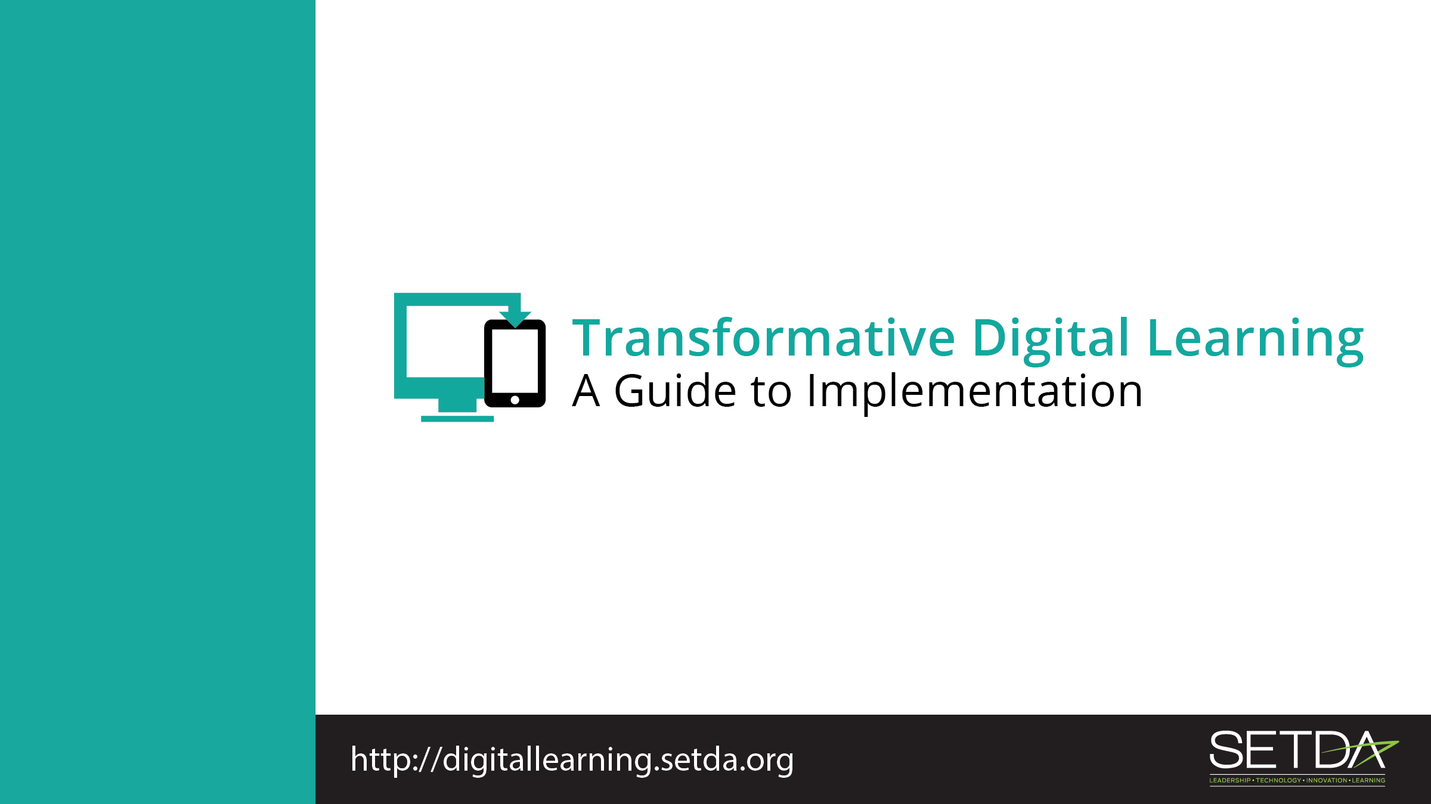
CIO/CTOs

Slide 2
Learning in the Digital Age
Technology is an essential component of learning today.
Students can
  Create content
  Interact with experts
  Collaborate with peers

Slide 3
Federal Policy Shift
Every Student Succeeds Act (ESSA) acknowledges technology’s role in revolutionizing learning
  Includes definitions for digital learning and blended learning
  References technology throughout the legislation
Notes:
S

Slide 4
Federal Policy Shift
National Education Technology Plan (NETP) calls for a “revolutionary transformation rather than evolutionary tinkering”
  Provide engaging and powerful learning experiences by leveraging technology
Notes:
Refer to Stakeholder toolkit, page 1-2.

Slide 5
Federal Policy Guidance
High-quality professional development to personalize learning and improve academic achievement
Build technological capacity and infrastructure
Innovative blended learning projects
Provide students in rural, remote, and underserved areas with the resources to benefit from high-quality digital learning opportunities
Deliver specialized or rigorous academic courses and curricula using technology, including digital learning technologies
Non-Regulatory Guidance Student Support and Academic Enrichment Grants Overview of Activities LEAs May Consider
Notes:
Refer to Stakeholder toolkit, page 1-2.

Slide 6
Role of CIO/CTOs
Essential role in strategic planning and vision setting
Understanding teacher and student needs for instructional materials and devices
Determining internet and wireless access points
Identifying key systems for data collection and assessment
Budgeting for technology

Slide 7

Attaining Broadband District-Wide
Notes:
Attaining Broadband District-Wide, Howard-Winneshiek Community Schools, Cresco, IA
Howard Winneshiek Community Superintendent John Carver discusses how to bring a rural district to a place of connectivity district-wide.
https://www.youtube.com/watch?v=4BpHXLQiQ1Q&index=38&list=PLhdwy3ASoEfku27IJ2HAKTJh-ACanSPsg

Slide 8
Budget
How are we going to pay for high-speed broadband, wireless access and devices?
Total Cost of Ownership
  Financial estimate that includes metrics and processes
Transformative Budgeting
  Model that accomplishes innovation within existing budgets
Notes:
Richland District Two, South Carolina partnered with Kajeet to offer internet hot spot devices to families with filtered internet broadband. When providing the devices to the family, the district explained that it was not only for students to complete homework, but also for the entire household to use to access community resources. Learn more at http://www.kajeet.net/engage-parents-richland-two. In Utah, the industry demand for robotics technicians locally is high. Local businesses approached the district to establish a robotics class where students learned to repair and program robots on a day-to-day basis. This initiative expanded to neighboring districts and the districts worked together to develop a robotics program and create degree opportunities for students. http://www.batc.edu/stem.

Slide 9
Connectivity
We are implementing a one-to-one initiative and using digital instructional materials. How do we ensure that our districts and schools have the necessary bandwidth to use digital resources?
SETDA Recommended Capacity Targets for 2017-2018 and 2020.
Building Technology Infrastructure for Learning Guide
Understanding types of available connectivity
Four paths for connecting districts and schools
Cost drivers and funding sources to consider
Special considerations for rural areas

Slide 10
Homework Gap
We know that some of our students are part of the homework gap. How can we ensure that all of our students have reliable access to digital tools and resources outside of school?
Partner with internet providers in the community to offer discounted service fees
Issue hot spots that students can take home
Adjust school library hours to offer more access.
Educate parents about the FCC Lifeline program
  Discounted internet service for low-income families
Notes:
Richland District Two, South Carolina partnered with Kajeet to offer internet hot spot devices to families with filtered internet broadband. When providing the devices to the family, the district explained that it was not only for students to complete homework, but also for the entire household to use to access community resources. Learn more at http://www.kajeet.net/engage-parents-richland-two. In Utah, the industry demand for robotics technicians locally is high. Local businesses approached the district to establish a robotics class where students learned to repair and program robots on a day-to-day basis. This initiative expanded to neighboring districts and the districts worked together to develop a robotics program and create degree opportunities for students. http://www.batc.edu/stem.

Slide 11
Student Data Privacy
How can our district improve our communication to staff and stakeholders about the importance of student data and how we safeguard the data?
How are you disseminating information about policies for accessing student data - who can access information, and what can be accessed?
How have you addressed student data privacy with your colleagues—chief academic officer, assessment officer, finance officer?
Trusted Learning Environment (TLE) seal is one way a school system can show their commitment to implementing practices and policies that protect student data privacy. This seal defines practices that districts should be undertaking around handling of student data

Slide 12
Thank You!
Learn more at:
Transforming Digital Learning: Toolkit to Support Educators and Stakeholders

